Slide 1
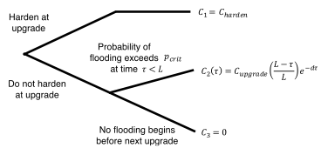
Robust Decision Making is used to inform idealized port investment decisions considering changes in flood risk due to sea-level rise.
Objective
Utilize probabilistic approaches to address two questions applied to investment decisions at the Port of Los Angeles:
(1) Under what future conditions would hardening of coastal facilities against extreme flood scenarios at the next upgrade pass a cost-benefit test?
(2) Do sea-level rise projections and other information suggest such conditions are sufficiently likely to justify such an investment?
Approach
Characterize deeply uncertain climate change projections of sea-level rise and impacts using Robust Decision Making analysis and full probabilistic approaches.
Figure: Simplified representation of Port of LA’s decision regarding whether or not to harden its terminal at its next upgrade and the costs resulting from its choices.
Sriver, R. L., Lempert, R. J., Wikman-Svahn, P., & Keller, K. (2018). Characterizing uncertain sea-level rise projections to support investment decisions, PLOS ONE 13(2), e0190641, https://doi.org/10.1371/journal.pone.0190641.
Impact
Results highlight the highly-localized and context dependent nature of applying Robust Decision Making methods to inform investment decisions.

