Slide 1
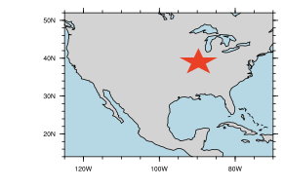
New tools to analyze extreme temperature in model ensembles and observational data products
Objective
Analyze mean and extreme temperature at regional scales in global climate model ensembles and evaluate skill based on the historical period
Approach
Utilize a block maxima approach to analyze extreme temperature distributions across spatial scales
Evaluate skill using root mean square error based on observational data sets
Quantify effects of internal variability, resolution, and different model structures on temperature distributions (bulk vs tails)
Temperature
Bulk Error
Impact
Daily average and extreme temperatures vary widely between different models and ensembles, which influences skill in both bulk and extreme temperature distributions
Results can help inform regional analysis particularly sensitive to extreme temperature (such as agriculture impacts)
Tail Error
Upper Left: Example temperature distribution highlighting bulk and tail areas. Upper Right: Example location for regional analysis. Lower: Results for central Illinois, showing skill in bulk temperature (y-axis) versus extreme temperature (x axis).
Hogan, E., Nicholas, R. E., Keller, K., Eilts, S., and Sriver, R. L. (2019). Representation of US Warm Temperature Extremes in Global Climate Model Ensembles, Journal of Climate, 32(9), 2951-2603. https://doi.org/10.1175/jcli-d-18-0075.1

