Slide 1
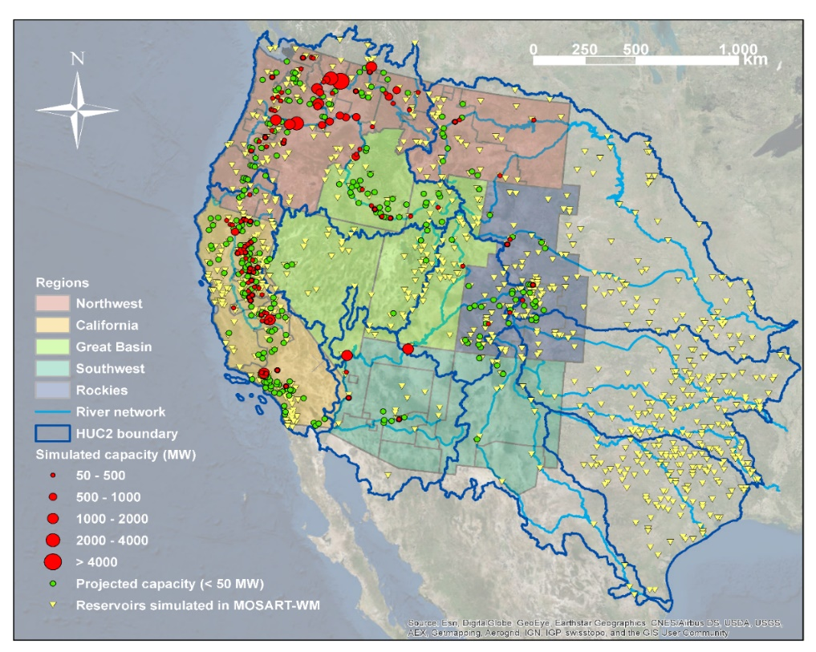
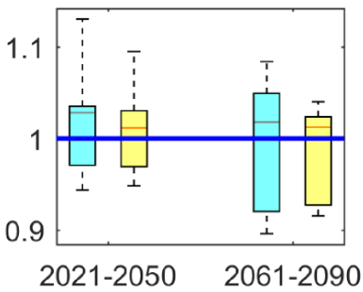
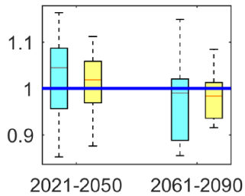
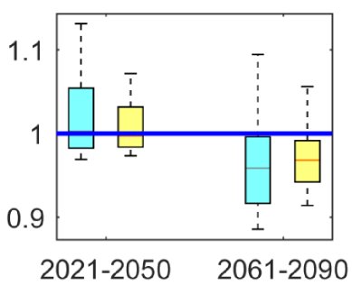
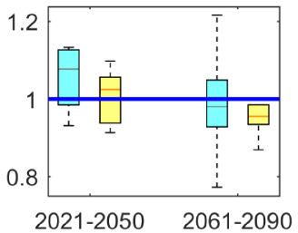
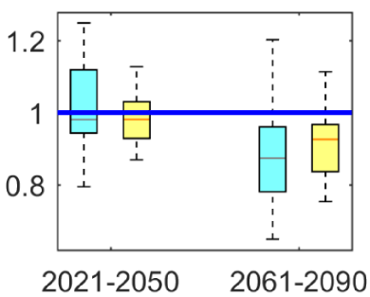
Improving Projections of Future Hydropower Changes in the Western United States
Objective
Reduce uncertainties in hydropower projections by accounting for hydrometeorological simulation biases and key operational constraints
Approach
In the context of a large-scale river-routing and water management model (MOSART-WM), develop a new process-based hydropower module that accounts for both environmental regulations and operational requirements for the electric power grid
Use a multiscale calibration approach to project hydropower generation for two different radiative forcing scenarios and 10 different downscaled Earth system models
Impact
New, more accurate projections of future hydropower generation demonstrate lower uncertainty in future seasonality shifts over the Western U.S.
The inclusion of more realistic constraints on hydropower production provides a platform for further exploration of coupled energy and water system dynamics.
Northwest
Great Basin
Rockies
California
Southwest
Comparison of future projections of normalized annual hydropower generation, relative to 1981-2010 (horizontal line), for five energy regions using a statistical approach (blue bars) versus a new process-based model (yellow bars).
Zhou, T., Voisin, N., & Fu, T. (2018). Non-stationary hydropower generation projections constrained by environmental and electricity grid operations over the western United States. Environmental Research Letters, 13(7), 74035. https://doi.org/10.1088/1748-9326/aad19f
Notes:
http://www.pnnl.gov/science/highlights/highlights.asp?division=749

