Slide 1
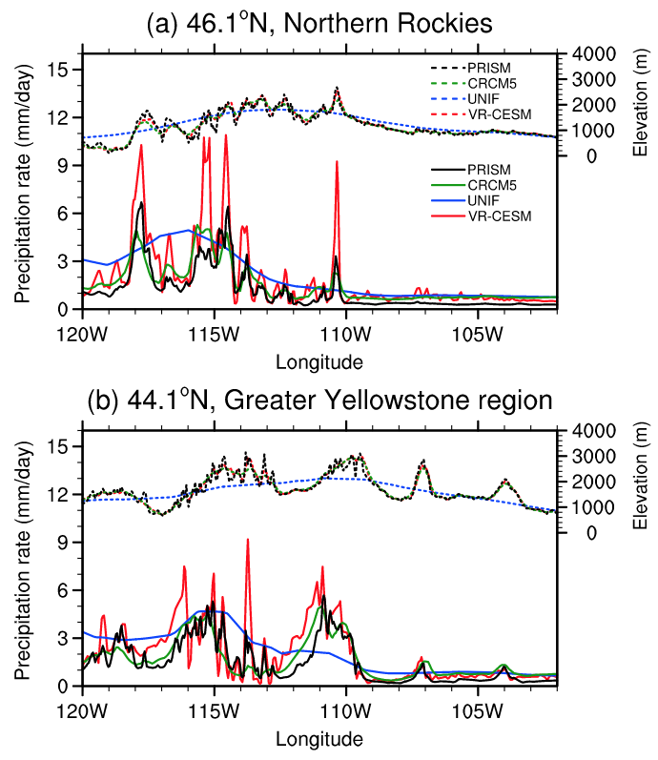
Exploring a Variable-Resolution Approach for Simulating Regional Climate in the Rocky Mountain Region Using the VR-CESM
A comprehensive investigation of how the variable-resolution CESM simulates the Rocky Mountain region when compared with observations and a regional model, particularly with respect to mountain snowpack, temperatures, and rain-on-snow events.
Variable-resolution global climate modeling systems provide significant value in regions of strong topographic variability, such as the Rocky Mountain region. This paper assesses this value in light of a comparable regional climate modeling system.
Variable-resolution in the Community Earth System Model (VR-CESM) was applied to simulate the historical period 1979-2005, with 14km resolution over the Rocky Mountain region.
Variable resolution demonstrated a significant improvement in the representation of topographically-dependent quantities, including precipitation and mountain snowpack. Performance was comparable to that of a RGCM.
Figure: Variation of wintertime mean precipitation for VR-CESM, UNIF, CRCM5, and PRISM along two transects through the Rocky Mountains.
Citation: Wu, C, X Liu, Z Lin, AM Rhoades, PA Ullrich, CM Zarycki, Z Lu, and SR Rahimi-Esfarjani. 2017. “Exploring a Variable-Resolution Approach for Simulating Regional Climate in the Rocky Mountain Region Using the VR-CESM.” Journal of Geophysical Research: Atmospheres 122(20): 10939-10965. https://doi.org/10.1002/2017JD027008.

