Slide 1
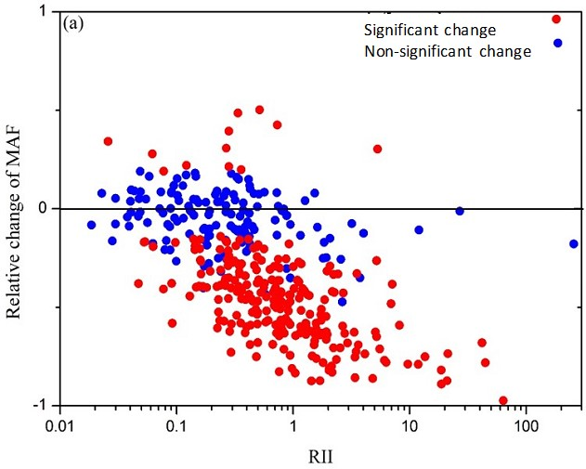
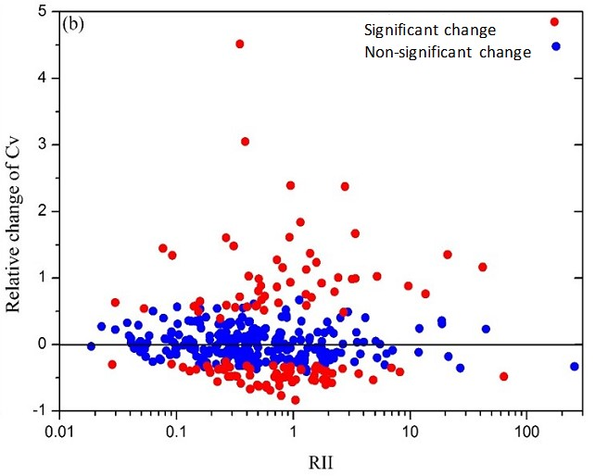
Reservoir Management Alters Flood Frequency at the Regional Scale
Objective
Present a new analytical framework to quantify effects of reservoirs as a nonlinear filter of runoff routing that alters flood frequency curve (FFC) characteristics
Approach
Define dimensionless Reservoir Impact Index (RII) to quantify reservoir regulation effects
Examine the shift of the FFC at 388 river stations in the contiguous United States for pre- and post-dam periods
Impact
Framework revealed nonlinear threshold behavior of how shape of FFC changes as function of reservoir regulation; results challenge traditional assumption of stationarity used in constructing the FFC
Pre- and post-dam flood records should be separately analyzed to derive piece-wise stable and stationary flood series; data would help guide regional-scale planning of hydraulic structures in complex river systems
The graphs show relative changes of (a) mean annual flood (MAF) and (b) coefficient of variation (Cv) between pre- and post-dam periods as a function of the Reservoir Impact Index (RII) at 388 river stations in the contiguous United States.
Wang, W., Li, H.Y., Leung, L. R., Yigzaw, W., Zhao, J., Lu, H., Deng, Z., Demisie, Y., & Blöschl, G. (2017) Nonlinear Filtering Effects of Reservoirs on Flood Frequency Curves at the Regional Scale. Water Resources Research, 53(10), 8277-8292. https://doi.org/10.1002/2017wr020871

