Slide 1
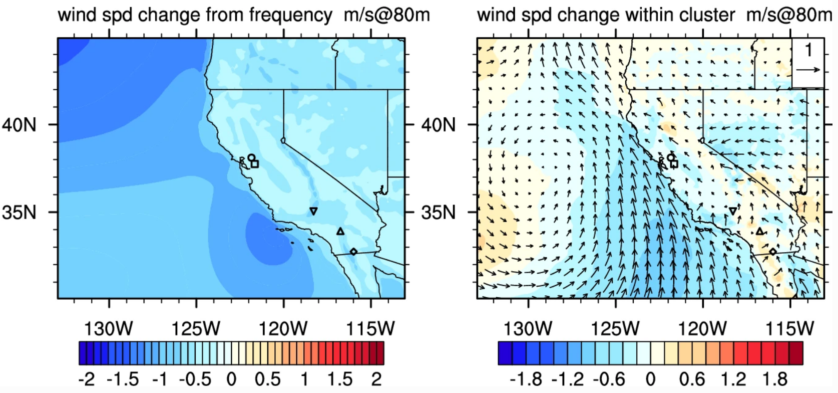
Using Cluster Analysis to Understand Future Changes in California’s Wind Patterns
By disentangling future change within common wind patterns in California into change from frequency and character, new insights emerge into how and why wind fields are changing. We explain how seasonal wind patterns are shifting, and how these changes ultimately impact wind energy production.
Figure: Wind speed change from frequency and character for North California pattern 1.
Although climate change is known to have a seasonally-dependent impact on the intensity of winds (and consequently wind energy production), most analyses only examine mean wind speed changes. Our novel approach enables us to understand which patterns are expected to become more/less frequent, and how wind patterns are changing.
Using cluster analysis, high-resolution historical and future 6-hourly hub-height wind fields produced using variable resolution in the Community Earth System Model are separated into common patterns.
Changes in those patterns are further separated into changes in the frequency of the pattern and change within the cluster.
The impacts of these changes on wind energy production is quantified at major wind farms.
Wang, M., P.A. Ullrich, and D. Millstein (2020) "Future projections of wind patterns in California with the Variable-Resolution CESM: A clustering analysis approach" Clim. Dyn. 54, pp. 2511-2531, doi: 10.1007/s00382-020-05125-5.

