Slide 1
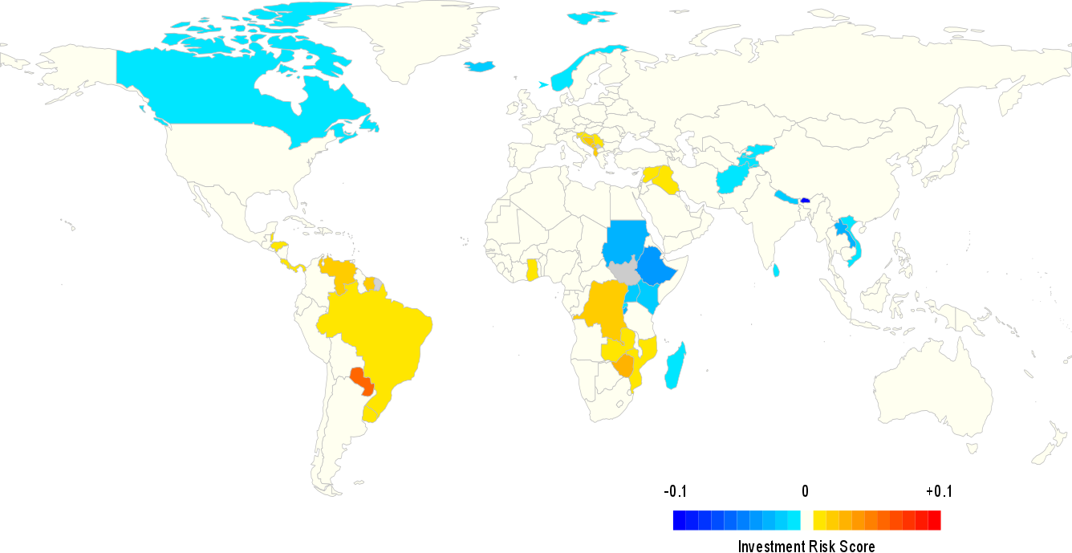
Future Hydropower Generation and Consequences for Global Electricity Supply
Objective
Assess how impaired or enhanced hydropower generation due to changes in future precipitation and temperature could affect power sector technology deployment and associated investment needs across the globe
Approach
Simulate power generation at ~1,600 large hydropower dams throughout the world
Implement resulting regional hydropower generation trajectories in the Global Change Assessment Model to simulate technology deployment in the 21st century
Assess risk and opportunity for individual countries
Opportunity
Risk
Changes in future precipitation and temperature present both opportunities and risks for hydropower generation around the globe.
Impact
Hydro-dependent countries in drying regions likely to need substantial investments (about $1 trillion in the 21st century) to address impaired power production
Canada, Norway, and a selection of South Asian countries could avoid substantial investments as increased precipitation raises output
Turner, S. W. D., Hejazi, M., Kim, S. H., Clarke, L., & Edmonds, J. (2017). Climate impacts on hydropower and consequences for global electricity supply investment needs. Energy, 141, 2081-2090. https://doi.org/10.1016/j.energy.2017.11.089
Notes:
http://www.pnl.gov/science/highlights/highlights.asp?division=749

