Slide 1
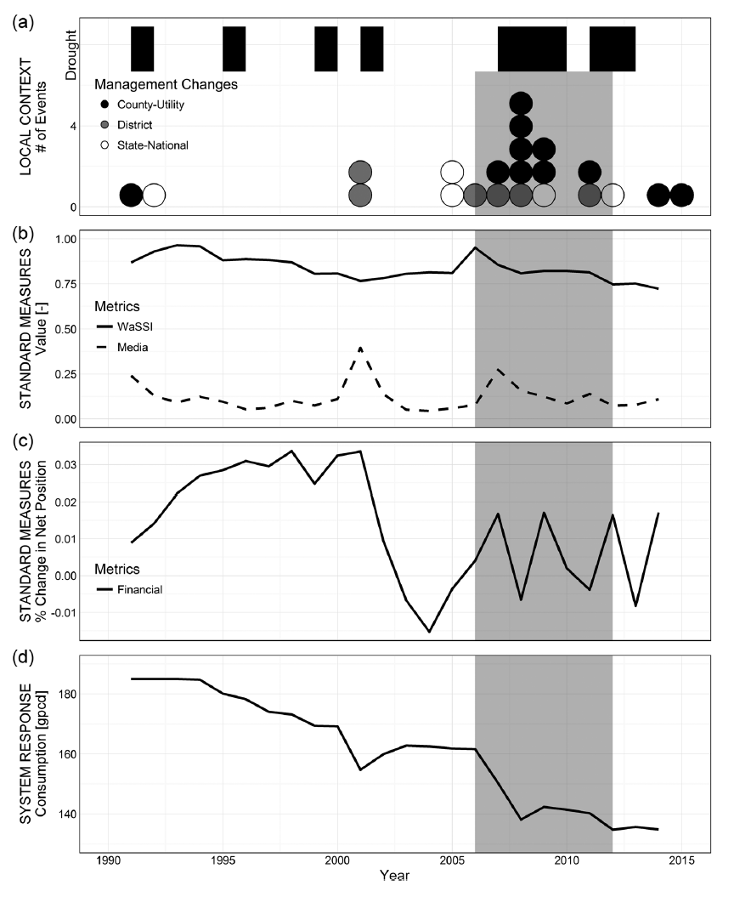
Complex Dynamics and Urban Water Transitions in Sustainable Water Management
Objective
Present a replicable methodology to analyze and understand complexity in transitions towards sustainability in urban water management while accommodating a city’s unique decision-making context.
Approach
Developed and tested proxy measures for the triple exposure theory of policy change via:
  Biophysical and regulatory pressures
  Media exposure
  Institutional and financial structure
Discussed opportunities to compare and contrast urban transitions to understand what factors hinder or enable transitions towards sustainability.
Impact
Identifies causal mechanisms behind obstacles to transitioning to sustainable urban water management
Transition timeline of water management change in Miami-Dade County with accelerated period of change marked in grey (a) key water supply management events (circles) and droughts (black bars); (b) normalized annual measures of water stress (WaSSI) with media attention (Media); (c) the annual measure of percent change in net position (Financial); and (d) annual per capita water consumption.
Treuer, G., Koebele, E., Deslatte, A., Ernst, K., Garcia, M., & Manago, K., (2016). A narrative method for analyzing transitions in urban water management: The case of the Miami-Dade Water and Sewer Department. Water Resources Research, 53(1), 891-908. https://doi.org/10.1002/2014WR015716

