Slide 1


The impact of parametric uncertainties on biogeochemistry in the E3SM v1 land model
Scientific achievement
A global sensitivity analysis was performed using a new methodology on the E3SM v1 land model (ELM v1), indicating the key parameters that drive uncertainty in model projections across 96 sites representing a wide range of climatic conditions and vegetation types.
Significance
Out of 68 model parameters analyzed, fewer than 20 have a significant influence on land model quantities of interest. These parameter sensitivities depend on climate variables, and are largely consistent among sites within a biome.
Impact
Understanding these sensitivities will aid in prioritization of model development and observations targeted to reduce prediction uncertainties. The methods developed here are a significant step towards formal model calibration at a global scale.
Sensitivity
Mix evergreen tree deciduous tree shrub/grass
Sensitivity of gross primary productivity (GPP) to E3SM land model parameters at 96 globally distributed FLUXNET sites, grouped by plant functional types.
Critical soil water potential
Stomatal conductance slope
Stomatal conductance intercept
Specific leaf area (canopy top)
Leaf carbon:nitrogen ratio
Fraction of leaf N in RuBisCO
Fine root carbon:nitrogen ratio
Fine root:leaf allocation ratio
Critical day length for senescence
Fraction of C storage allocated
Bulk dentrification rate
Base rate for plant respiration
T sensitivity for plant respiration
Ricciuto, D., Sargsyan, K., & Thornton, P. (2018). The impact of parametric uncertainties on biogeochemistry in the E3SM land model. Journal of Advances in Modeling Earth Systems, 10. https://doi.org/10.1002/2017MS000962.

Slide 2
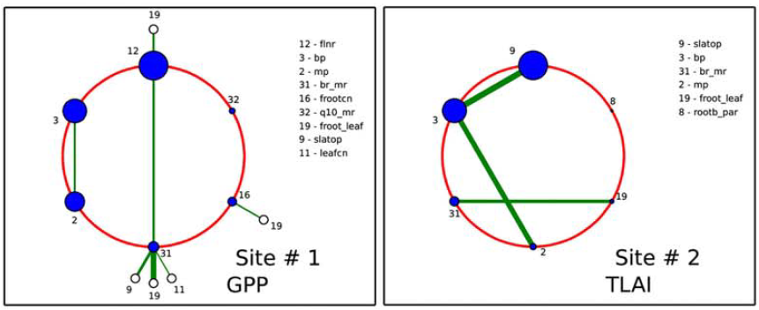
Sensitivities of gross primary productivity (left) and leaf area index (right) at two sites to E3SM land model parameters. The radii of circles correspond to the main sensitivities, while the green line widths correspond to joint sensitivities between the two connected parameters.

