Slide 1
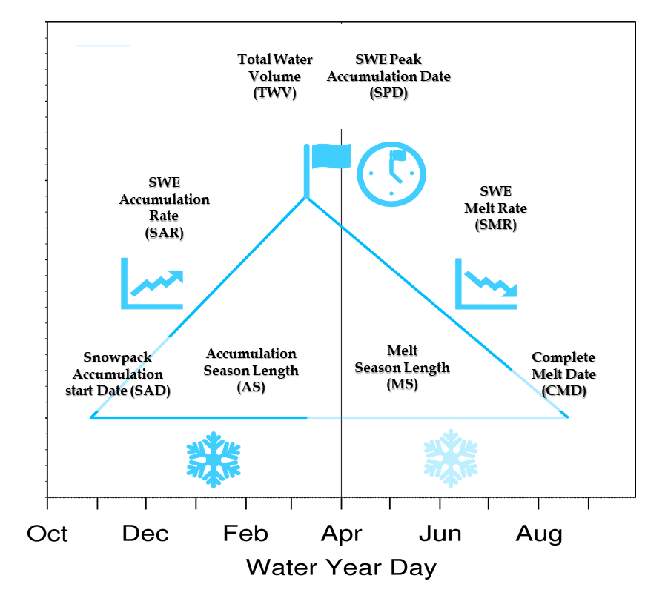
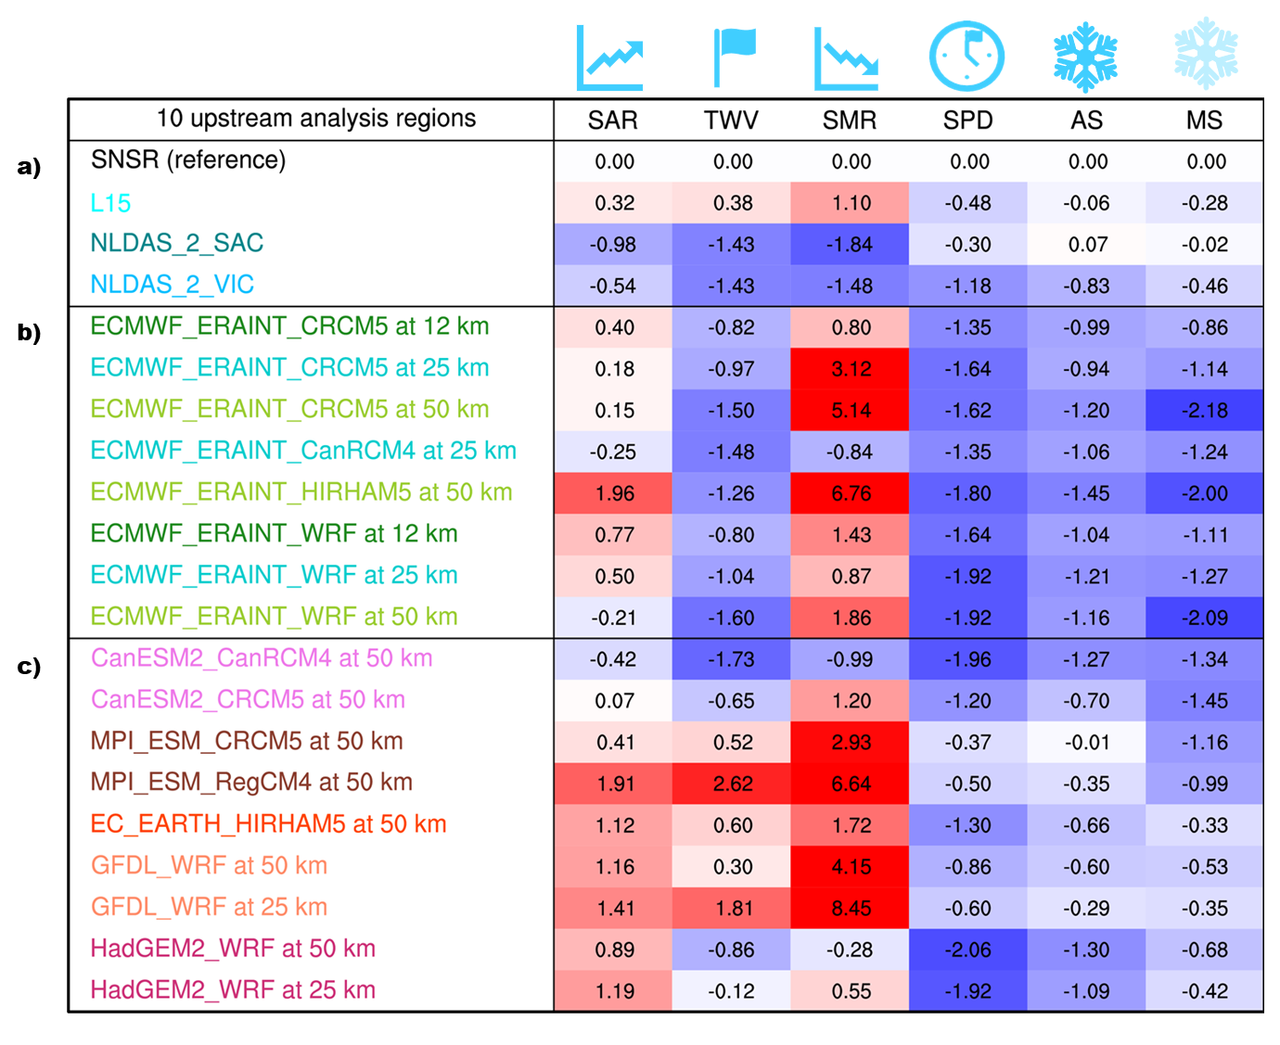
Improving the Simulation of Snowpack: Elucidating Error in Modeled Snow Processes
SWE triangle
Developed a multi-metric framework, the snow water equivalent (SWE) triangle, that helps to describe snowpack characteristics associated with total water volume build‐up, peak water availability, and the rate of water release. This approach can be applied across a wide-range of available snow products and highlights compensating errors that would not be reflected in conventional large‐scale spatiotemporal analysis.
All snow products analyzed show variation across the various SWE triangle metrics, even within observationally constrained snow products. This spread was especially shown in spring season melt rates. Due to the importance of snowmelt in reservoir management, addressing melt rate biases in climate models will be critical to maximize climate simulation utility for water stakeholders.
Error in snowpack measure - too low (too high)
Four observationally constrained snow products were intercompared for water years 1985-2005 in 10 reservoir headwater regions in California.
Similarly, eight (nine) atmospheric reanalysis (global climate model) driven regional climate model simulations from NA-CORDEX were juxtaposed to the observational products.
For the eight atmospheric reanalysis driven climate simulations, a general low accumulation rate and peak water volume along with too early of a peak timing and high melt rate was found.
For the nine global climate model driven regional climate simulations, melt rate biases became even worse than atmospheric reanalysis driven simulations.
A. M. Rhoades, A. D. Jones, and P. A. Ullrich. 2018. “Assessing Mountains as Natural Reservoirs with a Multi‐Metric Framework.” Earth’s Future 6(9): 1221-1241. https://doi.org/10.1002/2017EF000789.

