Slide 1
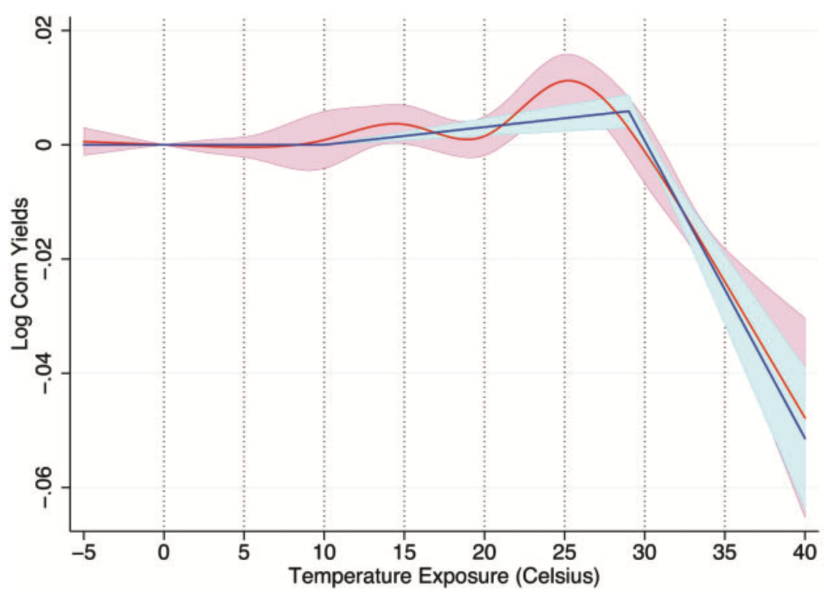
Panel data can identify highly nonlinear weather relationships
Objective
Discuss the use of panel data in agricultural impact assessments
Approach
Literature review of published articles
Presentation of latest results using flexible cubic splines
Impact
The literature over the last decade has seen an increase in the use of panel data studies
Panel studies use weather anomalies (deviations from average), which are random and exogenous.
Random weather variation is uncorrelated with other factors and hence allows the unbiased identification of a causal relationship with an outcome variable of interest
The difference between unpredictable weather variation and predictable difference in mean outcomes is discussed.
Blue line shows the piecewise linear relationship between US corn yields and temperature. The 95% confidence interval is added as shaded area. Red line shows the flexible cubic spline as well as its confidence band. The driving force are detrimental temperature effects above 29C.
Blanc, E., & Schlenker, W. (2017). The Use of Panel Models in Assessments of Climate Impacts on Agriculture. Review of Environmental Economics and Policy, 11(2), 258-279. https://doi.org/10.1093/reep/rex016

