Slide 1
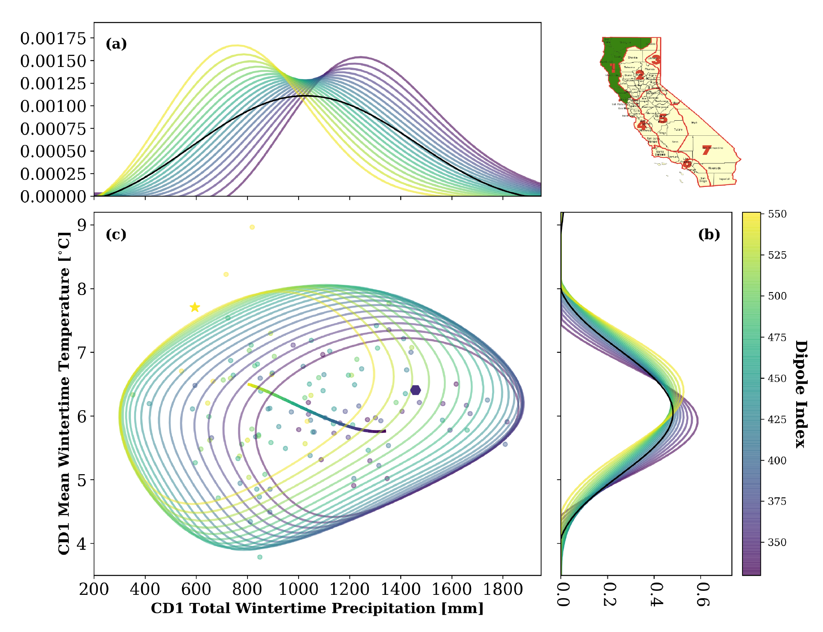



A New Method for Evaluating Controls on Heat and Drought Extremes
Demonstrates for the first time a method for understanding what controls the joint occurrence of heat and drought: for CA, this is a semi-permanent ‘dipole’ pattern of high/low pressure straddling the west coast.
Introduces a novel methodology that can be used to gain a better understanding of heat+drought extremes and can be used as a method for evaluating model performance.
The effect of the pressure dipole (DPI) on heat+drought extremes.
a ‘histogram’ of effects on drought (purple=low DPI, yellow=hi DPI).
effects on temperature.
effects on simultaneous heat+drought, showing that high DPI strongly favors warm, dry conditions in northern California
Uses a fast, robust probability estimation method (the LBL-developed fastKDE) to estimate the effect of various large-scale controls on heat+drought extremes
Explores the effects of: global mean temperature, El Niño, the dipole index, and numerous others
Shows that global mean temperature and the dipole index cause large variations in the joint statistics of heat and drought extremes for California.
O’Brien, J. P., O’Brien, T. A., Patricola, C. M., & Wang, S.-Y. S. (2019). Metrics for understanding large-scale controls of multivariate temperature and precipitation variability. Climate Dynamics. https://doi.org/10.1007/s00382-019-04749-6

