Slide 1



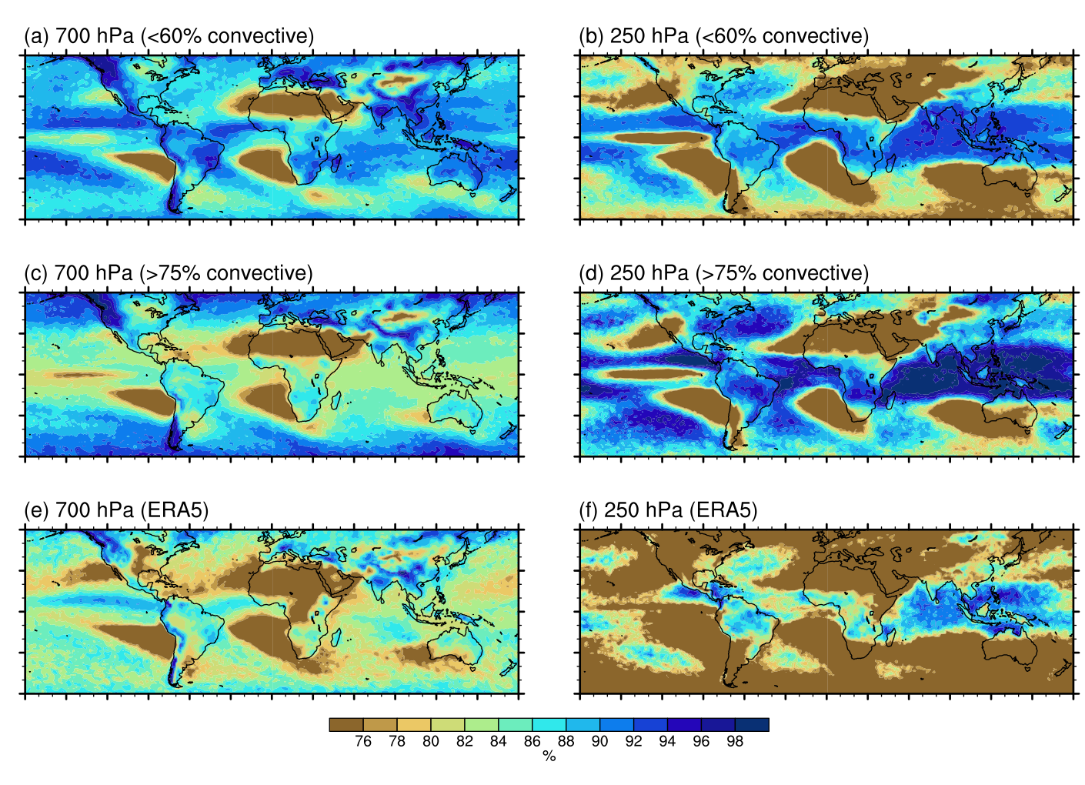
Climate models simulate extreme precipitation with sharply contrasting physical mechanisms
Problem
Global climate models are relied upon to estimate future intensification of extremes but their coarse resolution questions their reliability to do so.
Results
In mid-latitudes, model resolution is dominant factor in determining magnitude of extremes.
In tropics, GCMs with more precipitation from convective scheme simulate deeper convection but lower extreme-precipitation magnitudes.
Impact
This study highlights shortcomings of climate models’ representations of physics relevant to extreme precipitation. Our results suggest how parameterizations may be improved in order to make more reliable future projections of extreme precipitation.
Relative humidity at 700 (left panels) and 250 (right panels) hPa, conditioned on the 1-year event of daily precipitation. Top row: GCMs with <60% convective precipitation, averaged over the tropics. Second row: GCMs with >75% convective precipitation, averaged over the tropics. The third row shows ERA5.
Fig 1:
Reference: Norris, J., A. Hall, J. D. Neelin, C. W. Thackeray and D. Chen, 2021: Evaluation of the tail of the probability distribution of daily and sub-daily precipitation in CMIP6 models, J. Climate, doi:10.1175/JCLI-D-20-0182.1
Notes:
Figure Explanation: Individual models exhibit a wide range of surface warming trends (1979 – 2014) in the central Pacific (horizontal lines in lower left). This translates into a wide range of tropical tropospheric warming in individual model ensembles due to natural climate variability (scatter plot in the upper left and vertical lines in the upper right). Although tropical tropospheric warming does scale with climate sensitivity (ECS, upper right), models with both high and low climate sensitivity have individual realizations that are in accord with observed trends (dashed horizontal horizontal purple lines), which have been suppressed due to diminished central Pacific warming (purple box in upper left) and a La Nina like warming pattern (now shown).
Caption: Tropical mid-tropospheric (TMT) trend (1979 - 2014) versus the central Pacific (Nino 3.4) region SST trend for 482 CMIP6 historical simulations. Models are color-coded based on ECS, with the lowest ECS values in dark blue and highest ECS values in dark red. The range of observational values is denoted by the purple box. Horizontal lines indicate the range of Nino 3.4 trends for individual models with 5 or more ensemble members. The legend also provides the number of ensemble members, n, and the correlation coefficient, r, between the Nino 3.4 and tropical TMT trends for each model. The right side of the figure provides a similar color-coded display of the range of tropical TMT trends plotted against ECS (abscissa). Models with more than one ensemble member are displayed as vertical lines and models with only one ensemble member are denoted with dots.
<number>

