Slide 1
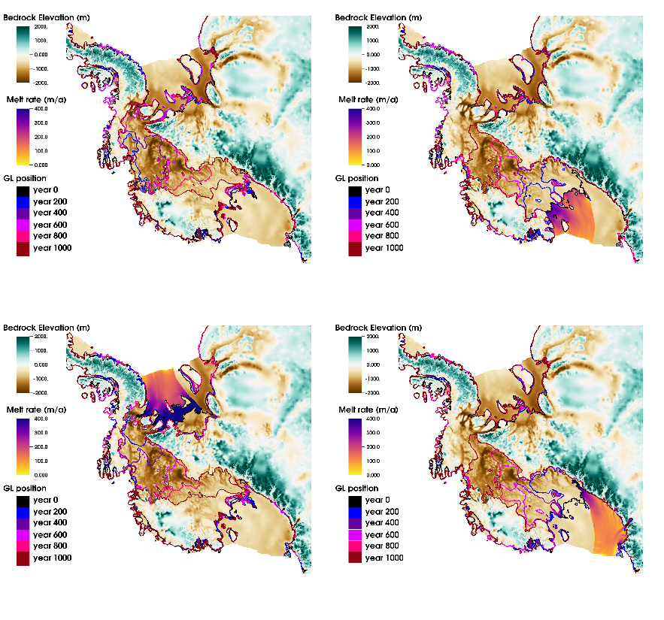
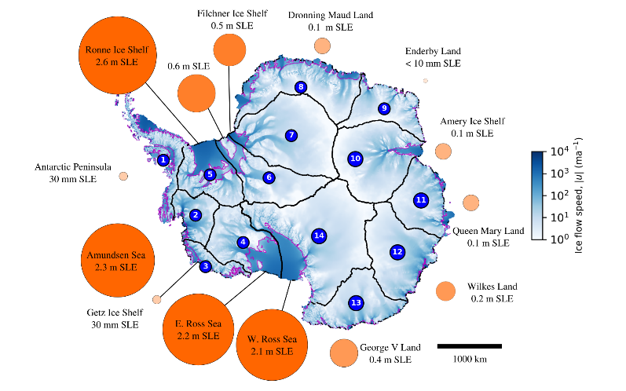




Millennial-scale Vulnerability of the Antarctic Ice Sheet to Regional Ice Shelf Collapse
Scientific Achievement
  We use a highly-resolved model of the
  Antarctic Ice Sheet to systematically
  examine vulnerability to regional
  collapse of its floating ice shelves
  and the potential for large resulting
  contributions to sea level rise (SLR).
Significance and Impact
  First fully-resolved, systematic study
  of millennial-scale ice sheet response
  to regional ice shelf collapse based on
  14 drainage basins.
  Sustained ice-shelf loss in any of the Amundsen Sea, Ronne, or Ross sectors can
  lead to wholesale West Antarctic ungrounding and collapse.
  Even with extreme forcing, loss is relatively modest for the initial century,
  increasing markedly afterward in West Antarctic collapse scenarios.
  Results indicate that Antarctic drainage basins are dynamically independent for 1-2
  centuries, after which dynamic interactions between basins become increasingly
  important (and regional modeling results will be increasingly inaccurate).
Research Details
  Systematically apply extreme thinning (up to 400m/year) to ice shelves in a single sector and then evolve ice sheet for 1000 years.
  Uses DOE SciDAC-supported BISICLES adaptive mesh refinement (AMR) ice sheet model which resolves flow down to 1km resolution, essential for accurately capturing realistic grounding line dynamics.
  The combination of scalable AMR and NERSC computing resources enabled this work, entailing 35,000 years of Antarctic simulation.
Left: Antarctic vulnerability to localized ice shelf collapse. Initial modeled flow speed is shown in shaded blue. Magenta lines indicate initial grounding-line locations. Mass loss above flotation (contribution to sea level rise, in eustatic sea level equivalent, SLE) after 1000 years of extreme, sustained ice shelf thinning originating in the numbered sectors is illustrated by the adjacent circle area.
Right: Grounding-line evolution illustrated with contours every 200 years for the Amundsen Sea (upper left), the Eastern Ross (upper right), the Ronne (lower left), and the Western Ross (lower right) sectors. Colormap shows initial melt-forcing distribution for each case.
Martin, Cornford, and Payne (2019). Geophysical Research Letters, DOI 10.1029/2018GL081229. Contact: Dan Martin (DFMartin@lbl.gov)
Notes:
Movies of the simulations in this work can be found at: https://drive.google.com/open?id=1aPvMSfB9imlNzlHinUn4wlgKmESpj2vL
The biggest uncertainty in near-future sea level rise (SLR) comes from the Antarctic Ice Sheet. Antarctic ice flows in relatively fast-moving ice streams. At the ocean, ice flows into enormous floating ice shelves which push back on their feeder ice streams, buttressing them and slowing their flow. Melting and loss of ice shelves due to climate changes can result in faster-flowing, thinning and retreating ice leading to accelerated rates of global sea level rise.
To learn where Antarctica is vulnerable to ice-shelf loss, we divided it into 14 sectors, applied extreme melting to each sector’s floating ice shelves in turn, then ran our ice flow model 1000 years into the future for each case. We found three levels of vulnerability. The greatest vulnerability came from attacking any of the three ice shelves connected to West Antarctica, where much of the ice sits on bedrock lying below sea level. Those dramatic responses contributed around 2m of sea level rise. The second level came from four other sectors, each with a contribution between 0.5-1m. The remaining sectors produced little to no contribution.
We examined combinations of sectors, determining that sectors behave independently of each other for at least a century.
Abstract: The Antarctic Ice Sheet (AIS) remains the largest uncertainty in projections of future sea level rise. A likely climate-driven vulnerability of the AIS is thinning of floating ice shelves resulting from surface-melt-driven hydrofracture or incursion of relatively warm water into subshelf ocean cavities. The resulting melting, weakening, and potential ice-shelf collapse reduces shelf buttressing effects. Upstream ice flow accelerates, causing thinning, grounding-line retreat, and potential ice sheet collapse. While high-resolution projections have been performed for localized Antarctic regions, full-continent simulations have typically been limited to low-resolution models. Here we quantify the vulnerability of the entire present-day AIS to regional ice-shelf collapse on millennial timescales treating relevant ice flow dynamics at the necessary ~1km resolution. Collapse of any of the ice shelves dynamically connected to the West Antarctic Ice Sheet (WAIS) is sufficient to trigger ice sheet collapse in marine-grounded portions of the WAIS. Vulnerability elsewhere appears limited to localized responses.

