Slide 1
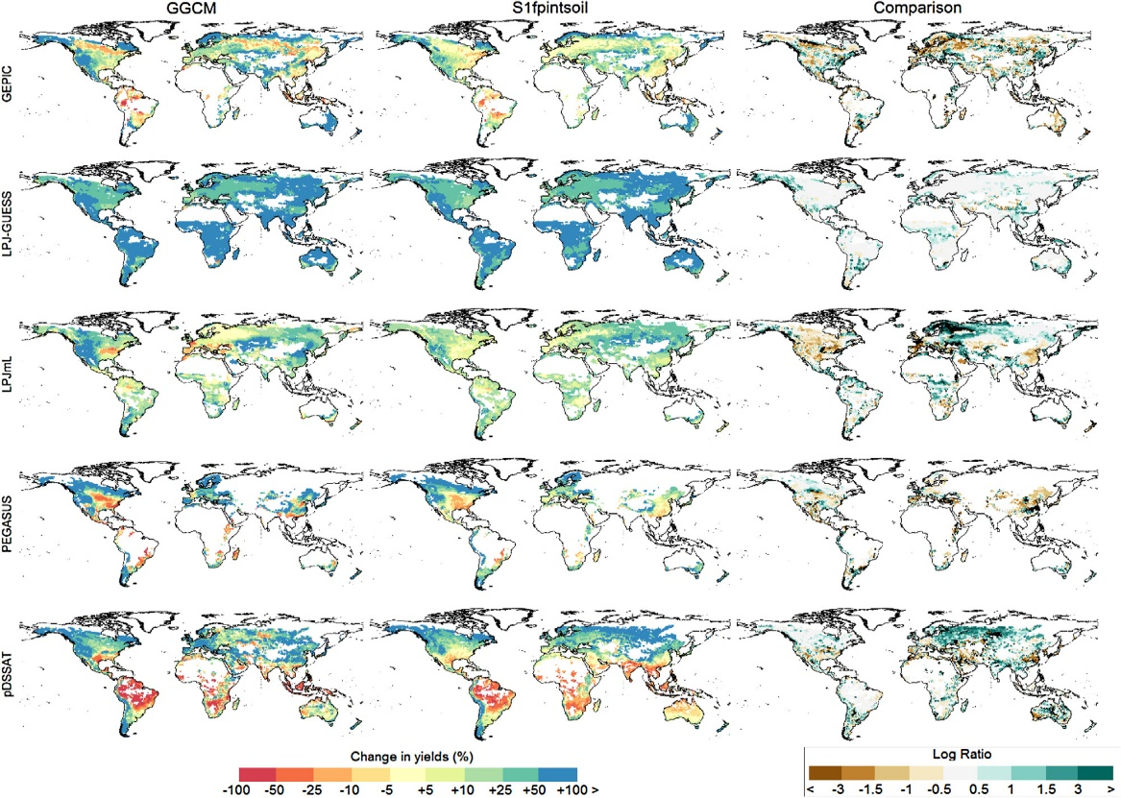
A simpler, faster way to assess environmental impacts on crop yields
Objective: Develop a reliable, more computationally efficient alternative to globally-gridded crop models (GGCMs) that can advance integrated assessment research addressing land-use change.
Findings: Using a suite of statistical models to predict responses of different crop yields to variations in temperature and precipitation, the study found good agreement between predictions from the statistical emulators and GGCMs.
Impact: This method provides a reliable method for incorporating environmental effects on crop yields and to study structural uncertainty in land-use change analysis.
Changes in wheat yields from 2000s to 2090s estimated by the statistical emulators (S1fpintsoil specification) and GGCMs and comparison (log ratio).
Blanc, E. (2017). Statistical emulators of maize, rice, soybean and wheat yields from global gridded crop models. Agriculture and Forest Meteorology, 236, 145-161. https://doi.org/10.1016/j.agrformet.2016.12.022

