Slide 1
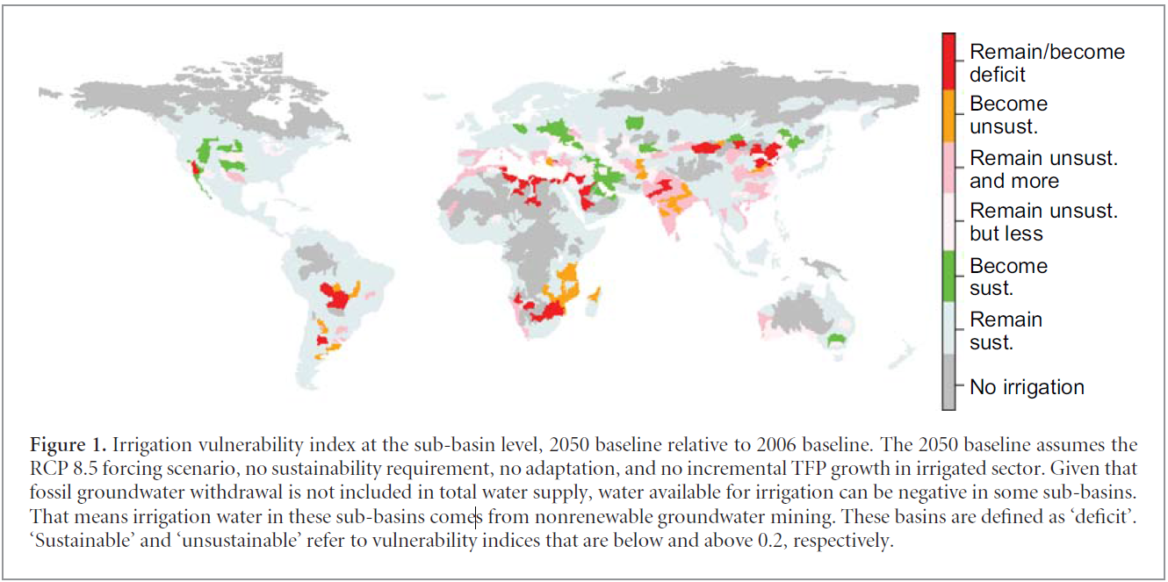
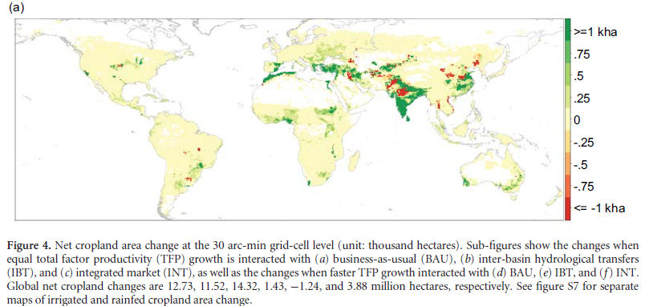
Achieving Sustainable Irrigation Water Withdrawals:
Global Impacts on Food Production and Land Use
Objective
Evaluate consequences of restricting unrenewable irrigation withdrawals for land use, terrestrial carbon and food security
Approach
Developed a grid-resolving partial equilibrium economic model SIMPLE-G and coupled it with Water Balance Model to assess the extent of unsustainable irrigation at the sub-basin level in 2050
Simulated the outcomes of eliminating unsustainable irrigation under two adaptation scenarios: inter-basin water transfers and international market integration
Impact
Our research shows that the pursuit of the UN sustainable development goals should not be done in isolation due to the potential tradeoffs across land, water, food and energy resources
This multi-scale modeling approach reveals heterogeneous local responses to system stresses, and can support more effective decision making.
Liu, J., Hertel, T.W., Lammers, R. B., Prusevich, A., Baldos, U. L. C., Grogan, D. S., and Frolking, S., (2017) Achieving sustainable irrigation withdrawals: global impacts on food security and land use. Environmental Research Letters, 12(10). https://doi.org/10.1088/1748-9326/aa88db

