Slide 1
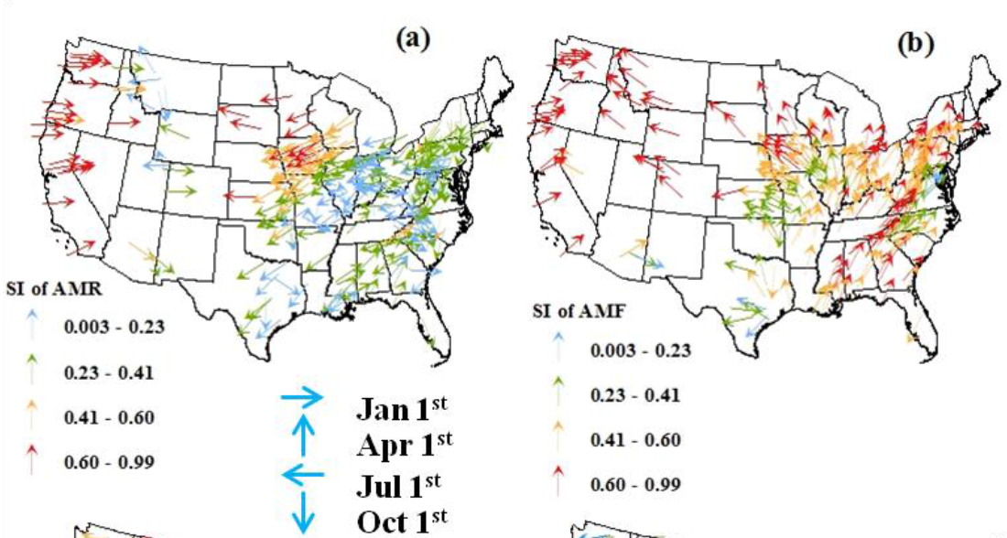
Understanding Flood Seasonality and its Temporal Shifts within the Contiguous United States
Objective
Understand processes that influence the seasonality of annual maximum floods (AMF) and its decadal changes in the United States
Approach
Quantify the seasonality (timing and amplitude) of annual maximum rainfall (AMR) and AMF at 259 catchments across the lower 48 United States
Evaluate the effects of antecedent soil moisture and the seasonal cycles of energy and water on AMR and AMF
Impact
In Eastern U.S., concurrent widespread increase in event rainfall magnitude and reduced soil water storage led to more variable timing of floods since 1980
Findings provide useful insights for understanding future changes in flood seasonality as Earth system models project changes in extreme precipitation and aridity over land
Seasonality of (a) AMR and (b) AMF at 259 U.S. catchments. Colors indicate the amplitude of seasonality, and the directions of the arrows indicate the timing of seasonality. The seasonality of AMF and AMF vary significantly across the catchments. In the West, the seasonality of AMF generally follows that of AMR, but the differences between the AMF and AMR seasonalities are notable in other regions, suggesting different mechanisms dominate the seasonality of AMF in different regions.
Ye S, H-Y Li, LR Leung, J Guo, Q Ran, Y Demissie, and M Sivapalan. 2017. “Understanding Flood Seasonality and its Temporal Shifts within the Contiguous United States.” Journal of Hydrometeorology 18(7):1997-2009. https://doi.org/10.1175/JHM-D-16-0207.1.
Notes:
http://www.pnnl.gov/science/highlights/highlights.asp?division=749

