Slide 1
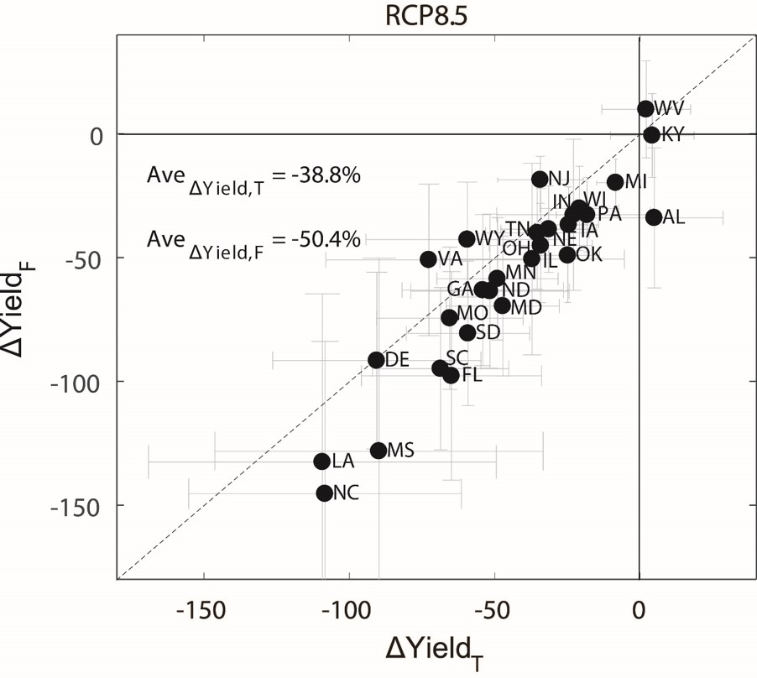
Kernels of Knowledge: How Land Use Decisions Affect Crop Productivity
Objective
Explore how changes in corn spatial distribution pattern modulate the crop yield’s response to Earth system changes over the lower 48 United States
Approach
Collect and process county-level corn yield, harvest area, and climate projections
Build two empirical models for projecting corn yield with one incorporating crop spatial distribution pattern change and the other using a fixed crop map, and compare the models’ estimated climate effects on corn yield
Impact
By 2050, corn yields in the lower 48 United States are predicted to decrease 20-40 percent under changing crop spatial patterns, compared to 26-52 percent with crop distribution patterns held constant.
Previous empirical studies could be biased in assessing effects of Earth system changes by ignoring the changes in crop spatial distribution pattern
Projected corn yield changes (%) by 2050 relative to 1970-1999 under the business-as-usual scenario (i.e., Representative Concentration Pathway, or RCP, 8.5) estimated by the two crop models. The projected yields (T and F) indicate the estimates by empirical models with and without considering the changes in crop growing pattern, respectively. Each dot indicates a corn-growing state, and the abbreviation of state name is labeled.
Leng, G., & Huang, M. (2017). Crop yield response to climate change varies with crop spatial distribution pattern. Scientific Reports, 7(1). https://doi.org/10.1038/s41598-017-01599-2
Notes:
http://www.pnnl.gov/science/highlights/highlights.asp?division=749

