Slide 1
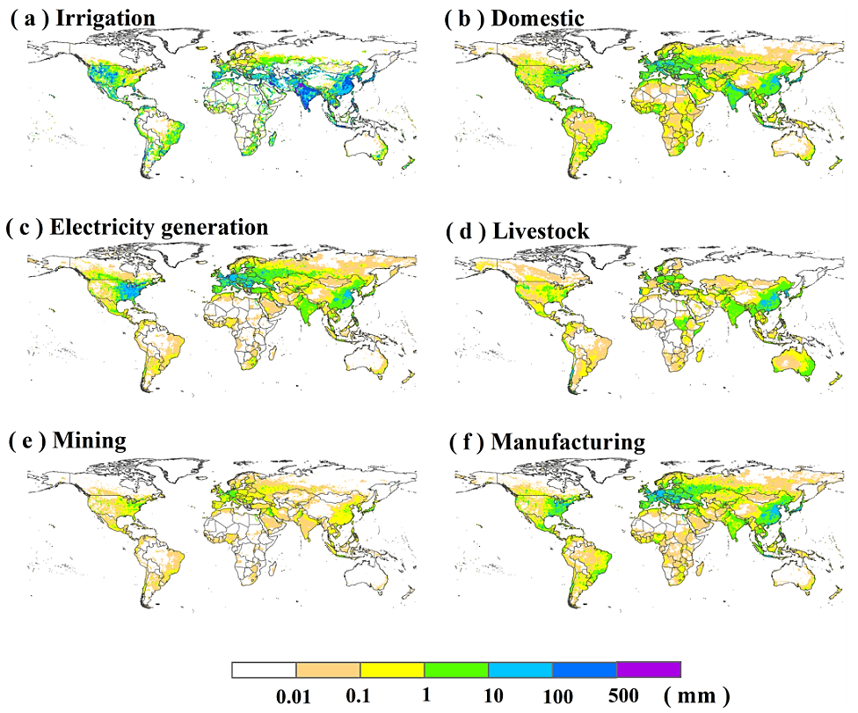
Reconstruction of Global Gridded Monthly Sectoral Water Withdrawals for 1971-2010 and Analysis of their Spatiotemporal Patterns
Objective
Estimate global gridded monthly water use between 1971 and 2010 for six water use sectors: irrigation, domestic, electricity generation, livestock, mining, and manufacturing
Approach
Combine reported water use estimates with modeling estimates to establish historical water use patterns
Use information such as population, livestock, and irrigation availability to downscale from country/state to grid level, and climate variables to downscale from annual to monthly time scale
Evaluate results against observations and simulation results in selected regions
Impact
The dataset can be used to represent historical human water use patterns in Earth system models and in model evaluation exercises
It can also support investigations of water-use related issues and patterns at fine space and time scales to help develop sound water management strategies
This map is an example from the global gridded dataset that shows the spatial distribution of annual mean water withdrawal in the six sectors.
Huang, Z., Hejazi, M., Li, X., Tang, Q., Vernon, C., Leng, G., Liu, Y., Doll, P., Eisner, S., Gerten, D., Hanasaki, Naota., & Wada, Y. (2018) Reconstruction of global gridded monthly sectoral water withdrawals for 1971-2010 and anlysis of their spatiotemporal patterns. Hydrology and Earth System Sciences, 22(4), 2117-2133. https://doi.org/10.5194/hess-22-2117-2018

