Slide 1
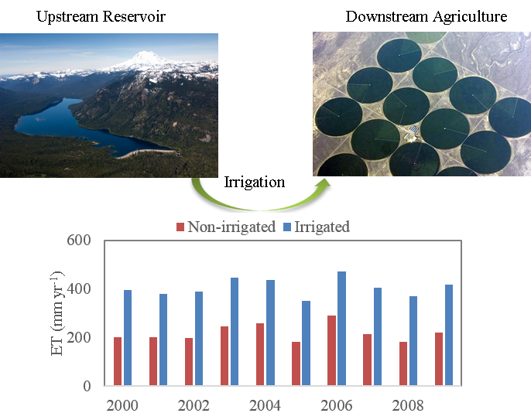
Accounting for Intensive Water Resource Management in a Semiarid Watershed
Objective
Assess the implications of crop irrigation and reservoir operations on water resources and water cycling in an intensively managed semiarid watershed
Approach
Combine a detailed watershed model (SWAT) with a river flow simulation model (RiverWare) to simulate the combined effects of reservoir operations and crop irrigation in the Yakima River Basin
Evaluate the performance of this integrated modeling system against long-term streamflow and evapotranspiration data
Impact
Reservoir-enabled irrigation of crops nearly doubles evapotranspiration in the basin, reducing net downstream flows
The integrated modeling system used in this study can be used to improve water availability analyses in other basins
Results are sensitive to assumptions regarding groundwater withdrawal rates, irrigation efficiencies, and return flows, indicating targets for future work
Irrigation of croplands, facilitated by capturing springtime snowmelt in upstream reservoirs and releasing that water later in the growing season, results in doubling of surface evapotranspiration in the Yakima River basin.
Qiu, J., Yang, Q., Zhang, X., Huang, M., Adam, J. C., & Malek, K. (2019). Implications of water management representations for watershed hydrologic modeling in the Yakima River basin. Hydrology and Earth System Sciences, 23(1), 35-49. https://doi.org/10.5194/hess-23-35-2019
Reservoir picture from Yakima Basin Integrated Water Resource Management Plan
Notes:
http://www.pnnl.gov/science/highlights/highlights.asp?division=749

