Slide 1
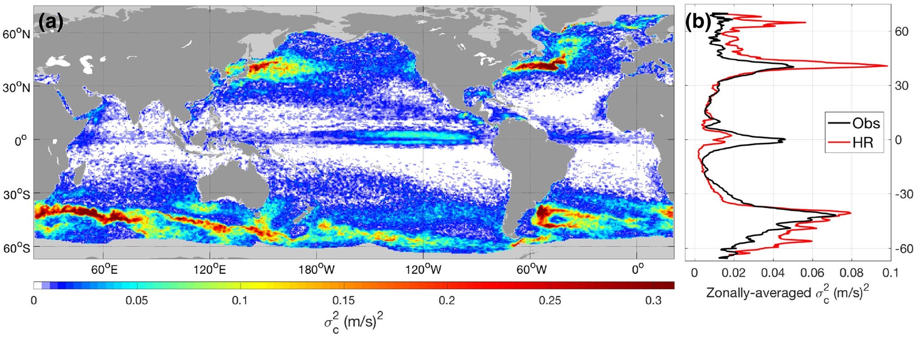
Ocean Eddy Air-Sea Interactions
Coherent ocean eddies drive air–sea coupling characteristics as revealed in 10-m wind speed anomalies. Resolved ocean eddy coupled simulations (HR) capture observed active regions that are absent in typical IPCC class models.
Panel a shows the variance distribution of the SST-driven 10-m wind speed anomalies inferred from HR data and b the meridional profile of its zonally-averaged values (red line) compared with that from satellite observations (black): Laurindo, L. C., L. Siqueira, A. J. Mariano, and B. P. Kirtman, 2018. “Cross-spectral analysis of the SST/10-m wind speed coupling resolved by satellite products and climate model simulations.” Climate Dynamics. https://doi.org/10.1007/s00382-018-4434-6.

