Slide 1
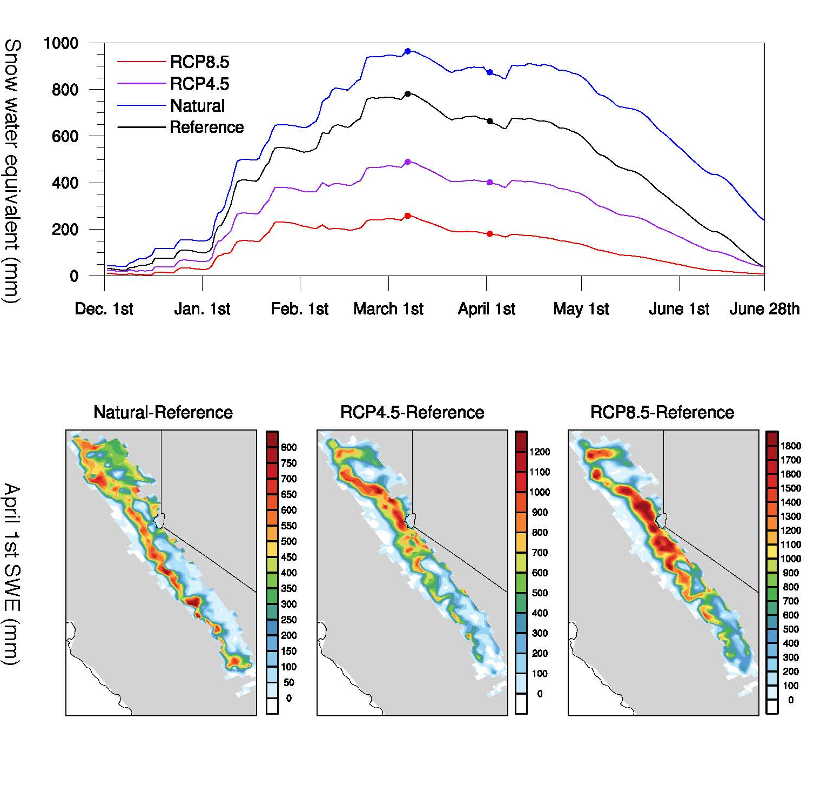
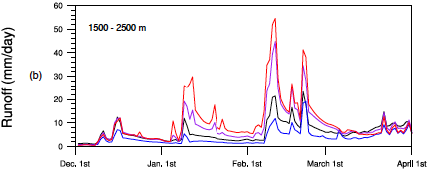

Anthropogenic Warming Impacts on Today’s Sierra Nevada
Snowpack and Flood Risk
This study investigates temperature impacts to snowpack and runoff-driven flood risk over the Sierra Nevada during the extremely wet year of 2016-2017. Significant findings have been revealed related to recent public-aware precipitation extremes.
Revealing the existing impacts of the Sierra Nevada hydrology by human-induced warming and continuing impact under future warming. Current wet year put in the future will be almost like a nowadays' dry year. Intensified flood risk due to increased runoff over heavy-rainy days.
By perturbing near-surface temperatures from a 9 km dynamically downscaled simulation, a series of offline land surface model experiments explore how Sierra Nevada hydrology has already been impacted by historical anthropogenic warming and how these impacts evolve under future warming scenarios.
The added warming is derived from simulated average monthly temperature increases in California by the end of the 21st century under Representative Concentration Pathway (RCP) emissions scenarios 4.5 and 8.5, i.e. RCP4.5 and RCP8.5
Shared Data: http://portal.nersc.gov/project/m2637/snowpack/
Huang, X., Hall, A. D., & Berg, N. (2018). Anthropogenic Warming Impacts on Today’s Sierra Nevada Snowpack and Flood Risk. Geophysical Research Letters, 45(12), 6215-6222. https://doi.org/10.1029/2018gl077432

