Slide 1
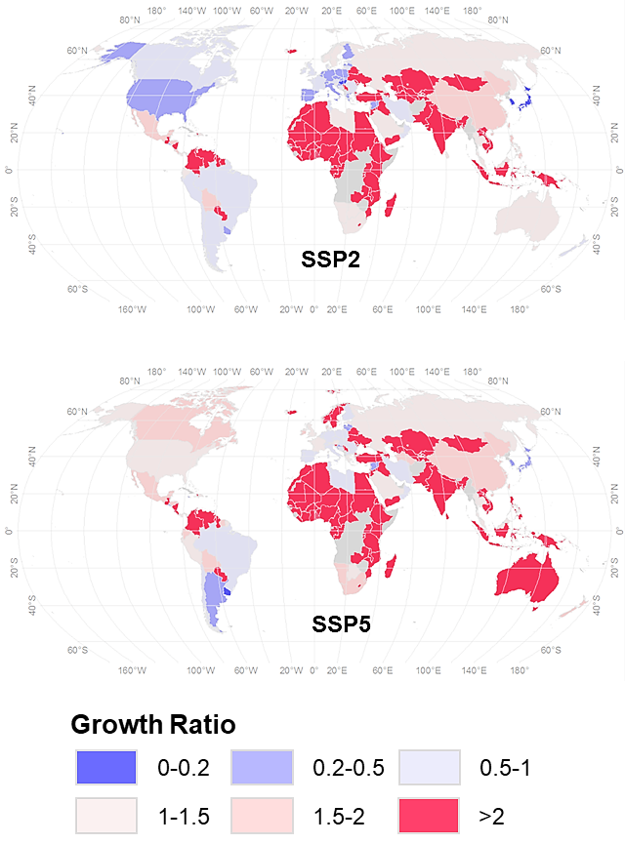
Projecting Global Urban Area Growth Through 2100 Based on Historical Time Series Data and Future Scenarios
Objective
Provide a global projection of future urban area growth for all countries
Approach
Develop country-specific urban area growth models using historical time series data (1992–2013) for urban areas from satellite observations
Project future global urban area growth under different socioeconomic pathways through 2100
Impact
Rapid urbanization over past decades has important influences on dynamics at local, national, and global scales.
Understanding the ongoing urbanization and quantifying its pace and magnitude going forward are crucial for research on future interactions among urban systems, other human systems, and the environment.
This first data set on country-level urban extents under different socioeconomic pathways between 2013 and 2100 has great potential to support global change studies, such as simulating urban sprawl, modeling multisector dynamics, and the effect of urbanization on air quality, and human health.
Urban area growth ratio by 2100 (compared to 2013) at the country level under different future scenarios
Li, X., Zhou, Y., Eom, J., Yu, S., & Asrar, G. R. (2019). Projecting Global Urban Area Grwoth Through 2100 Based on Historical Time Series Data and Future Shared Socioeconomic Pathways. Earth's Future 7(4), 351–362. https://doi.org/10.1029/2019EF001152
Notes:
http://www.pnnl.gov/science/highlights/highlights.asp?division=749

