Slide 1
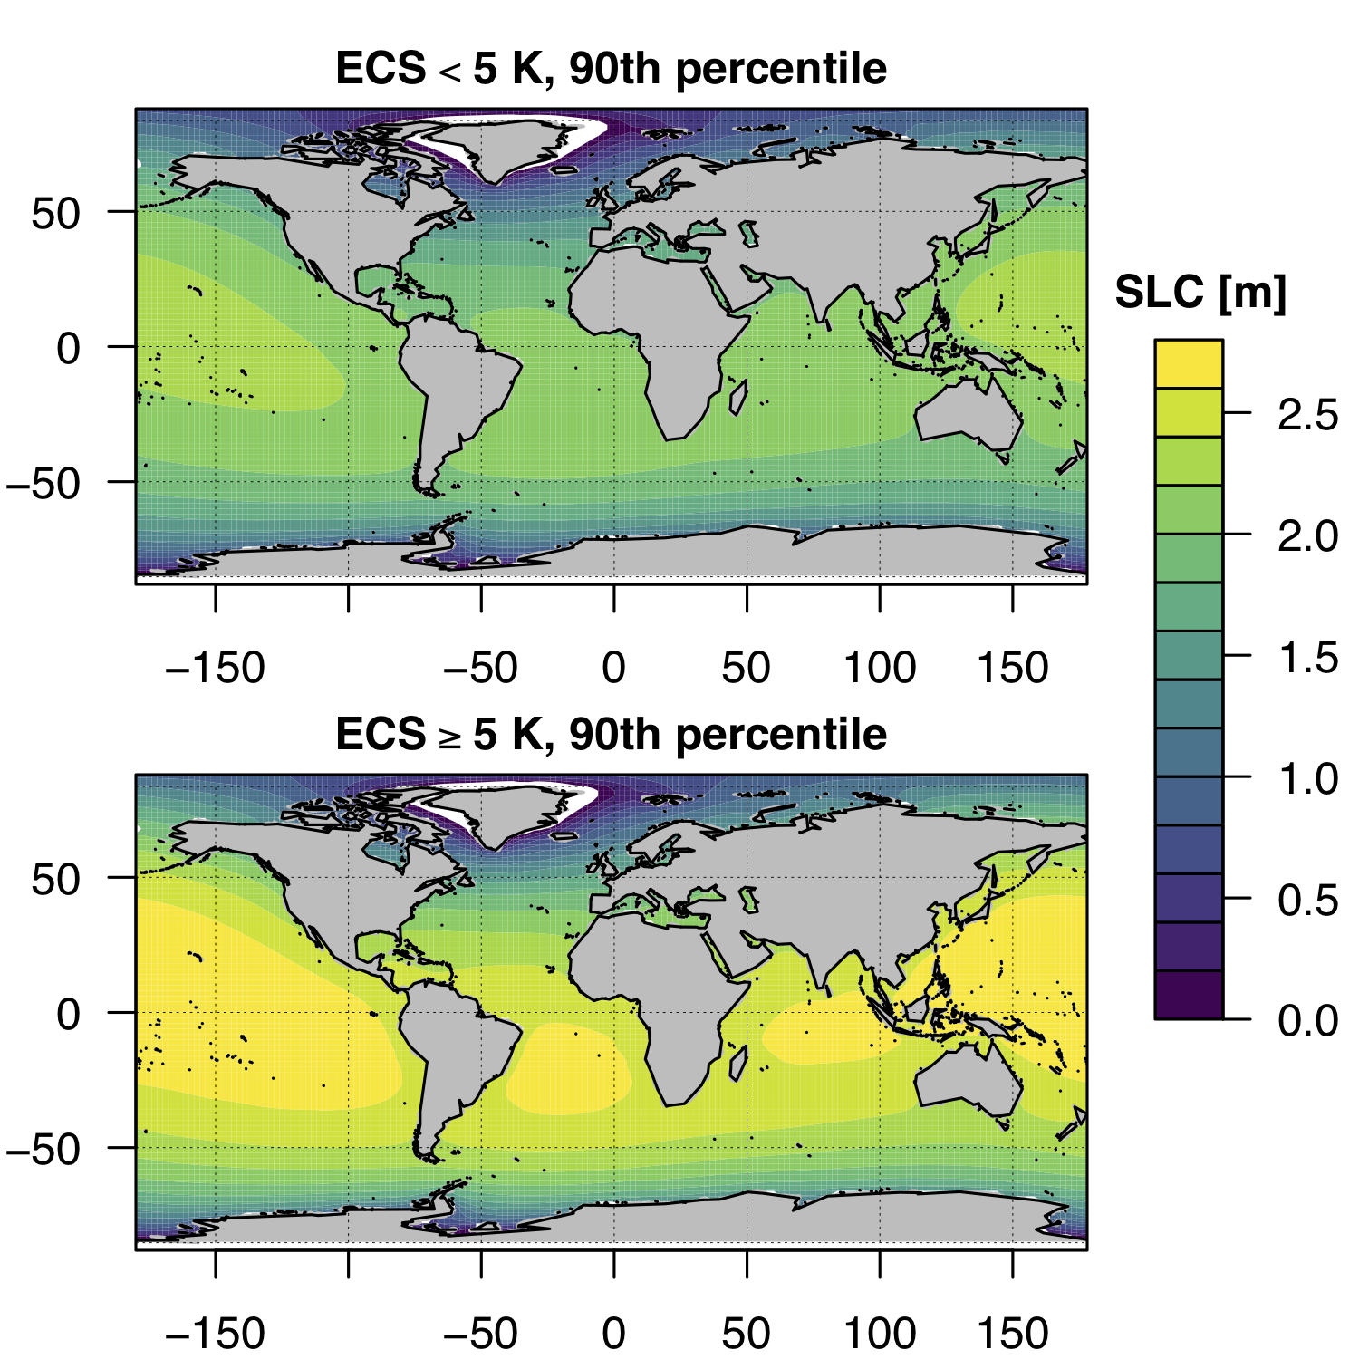
The Role of Climate Sensitivity in Upper-Tail Sea Level Rise Projections
Objective
Analyze the effect of high climate sensitivity on sea level rise projections using a reduced complexity Earth system model called Hector-BRICK
Approach
Analyzed temperature and sea level responses in Hector-BRICK with high and low equilibrium climate sensitivity scenarios, as well as different representative concentration pathways
Employed Bayesian calibration using multiple atmosphere and ocean observational constraints to compare and contrast model sensitivities
Used spatial fingerprinting to highlight upper-tail sea level rise outcomes (above 90th percentile) at global to regional scales
Impact
Modeled sea level projections, particularly at the upper tail, depend substantially on equilibrium climate sensitivity
Results influence regional sea level change projections and the timing of sea level rise exceedances
Variation in the 90th percentile of global sea level change (SLC) projections in 2100 for low (top) and high (bottom) equilibrium climate sensitivity scenarios shows that these projections depend substantially on climate sensitivity.
Vega-Westhoff B, RL Sriver, CA Hartin, TE Wong, and K Keller. 2020. “The Role of Climate Sensitivity in Upper‐Tail Sea Level Rise Projections,” Geophysical Research Letters, 47: e2019GL085792.
DOI: 10.1029/2019GL085792

