Slide 1
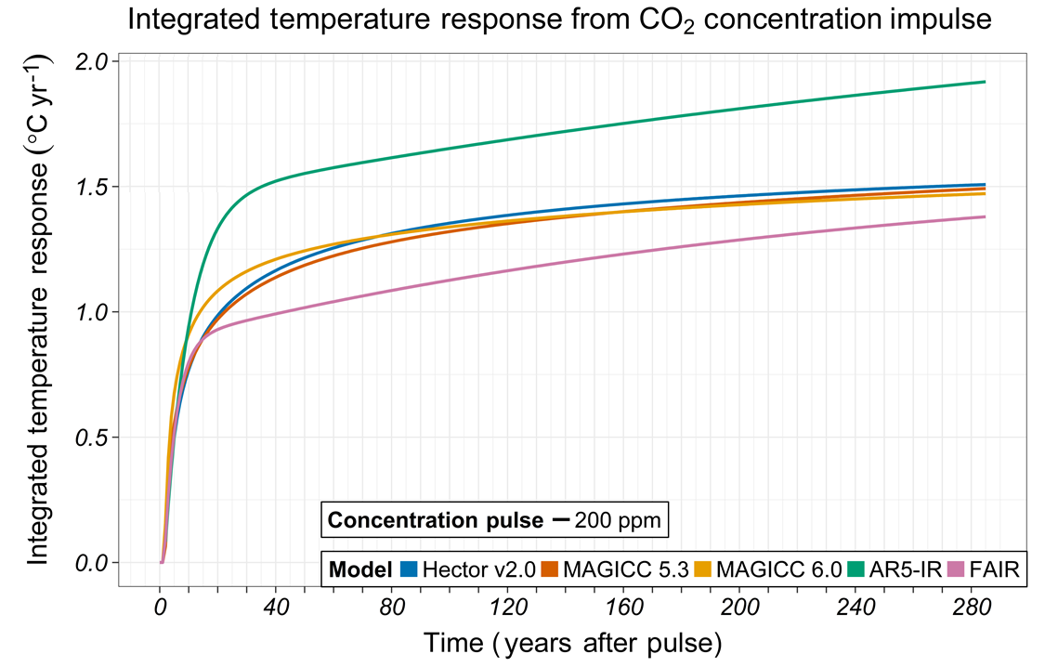
Evaluating Climate Model Emulators
Objective
Evaluate fundamental behavior of simple climate models (SCMs) by examining their response to a suite of standardized impulse tests
Approach
Evaluate how five simple climate models respond to a set of emission and concentration perturbations
Impulse (a one-year perturbation) and step (multi-year increase) changes were used
These standardized tests allow comparisons between simple models
For some responses, the tests also allow comparisons between SCMs and more complex Earth system models
Impact
The responses reveal fundamental model behavior
Tests reveal differences in behavior between SCMs including their temperatures response to forcing and gas-cycle responses to emissions
Tests can be used to diagnose the impact of future model changes on fundamental behavior
This work reveals opportunities for improving SCMs
This figure shows the integrated temperature response to a one-year concentration impulse for five simple climate models. The three process-based SCMs (Hector and MAGICC 5.3, 6.0) respond in a similar manner. Idealized SCMs (FAIR, AR5-IR) can show biases in responses.
Schwarber A, SJ Smith, CA Hartin, BA Vega-Westhoff, and R Sriver. 2019. “Evaluating Climate Emulation: Fundamental Impulse Testing of Simple Climate Models,” Earth System Dynamics, 10: 729–739.
DOI: 10.5194/esd-10-729-2019
Notes:
http://www.pnnl.gov/science/highlights/highlights.asp?division=749

