Slide 1
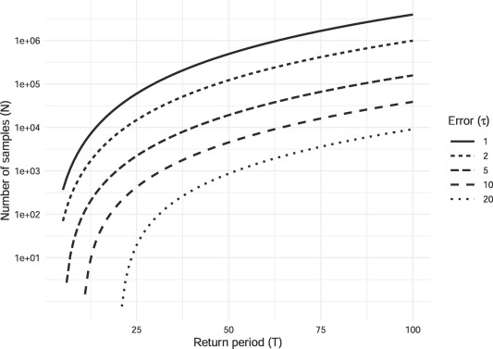
100 Years of Data Is Not Enough to Establish Reliable Drought Thresholds
Objective
Quantitatively assess the statistical uncertainty surrounding hydrologic drought thresholds
Approach
Derive formulae for calculating the statistical uncertainties caused by limited record lengths, and for estimating the record length needed to achieve a specified threshold accuracy
Impact
In studies seeking to project future long-term changes in drought conditions, drought thresholds are commonly used to define when a region is—or is not—experiencing a drought
Drought threshold uncertainty is not well-quantified in the scientific literature, despite the widespread use of thresholds in drought studies
This study raises the hydrology community’s awareness of this issue by assessing threshold uncertainties, identifying record lengths required to achieve high threshold reliability, and summarizing options for augmenting the historical record to increase threshold reliability
This work helps researchers quantify the uncertainty inherent in drought thresholds defined using limited historical datasets. The figure above shows that even with 1000 samples (years of hydrologic data), the uncertainty on the estimate of a 50-year return period (drought threshold) is ±20 years.
R. Link, T.B. Wild, A. Snyder, M. Hejazi, and C. Vernon. “100 Years of Data is not Enough to Establish Reliable Drought Thresholds,” Journal of Hydrology 7:100052. DOI: 10.1016/j.hydroa.2020.100052

