Slide 1
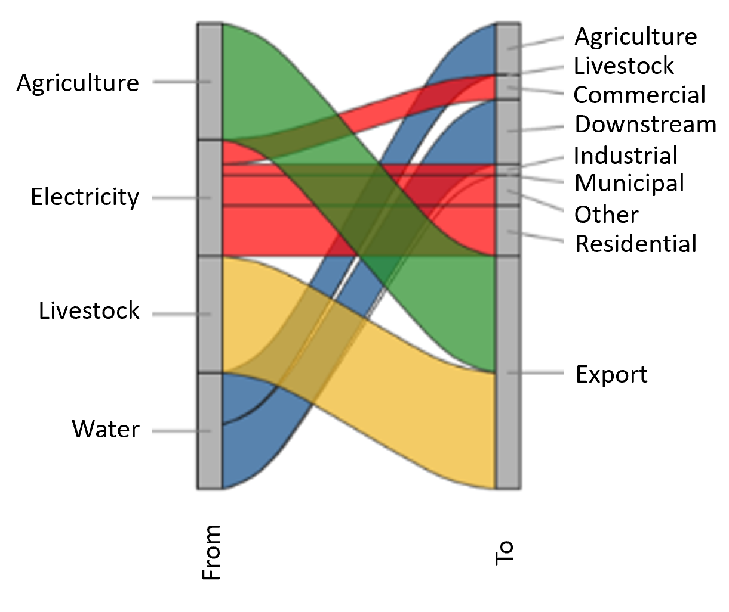
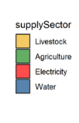
Harmonizing and Analyzing Multi-Sectoral Dynamics at Flexible Spatial Scales
Objective
Compare, manipulate, and harmonize multi-sector data and inter-linkages at sub-regional spatial scales
Approach
Use the Global Change Analysis Model (GCAM) to capture global dynamics across human and earth systems downscaled to grid scale
Re-aggregate data up to sub-regional scale (e.g., sub-basin, sub-state)
Generate inter-sectoral linkages at the specified scales
Impact
The importance of holistic multi-sectoral modeling at multiple scales is well established in the literature, but implementation in practice remains a challenge
Metis provides an efficient modeling platform to easily analyze and evaluate the impacts of different global and regional drivers across sectors at finer spatial scales than typically modeled in GCAM
The open-source software program Metis provides a platform to explore energy, water, and land dynamics at flexible spatial scales. In this figure, energy flows from sectors ranging from agriculture to residential.
Khan Z, T Wild, C Vernon, A Miller, M Hejazi, L Clarke, F Miralles-Wilhelm, RM Castillo, F Moreda, JL Bereslawski, M Suriano, and J Casado. 2020. “Metis – A Tool to Harmonize and Analyze Multi-Sectoral Data and Linkages at Variable Spatial Scales,” Journal of Open Research Software 8:10.
[DOI: 10.5334/jors.292]
Notes:
http://www.pnnl.gov/science/highlights/highlights.asp?division=749

