Slide 1
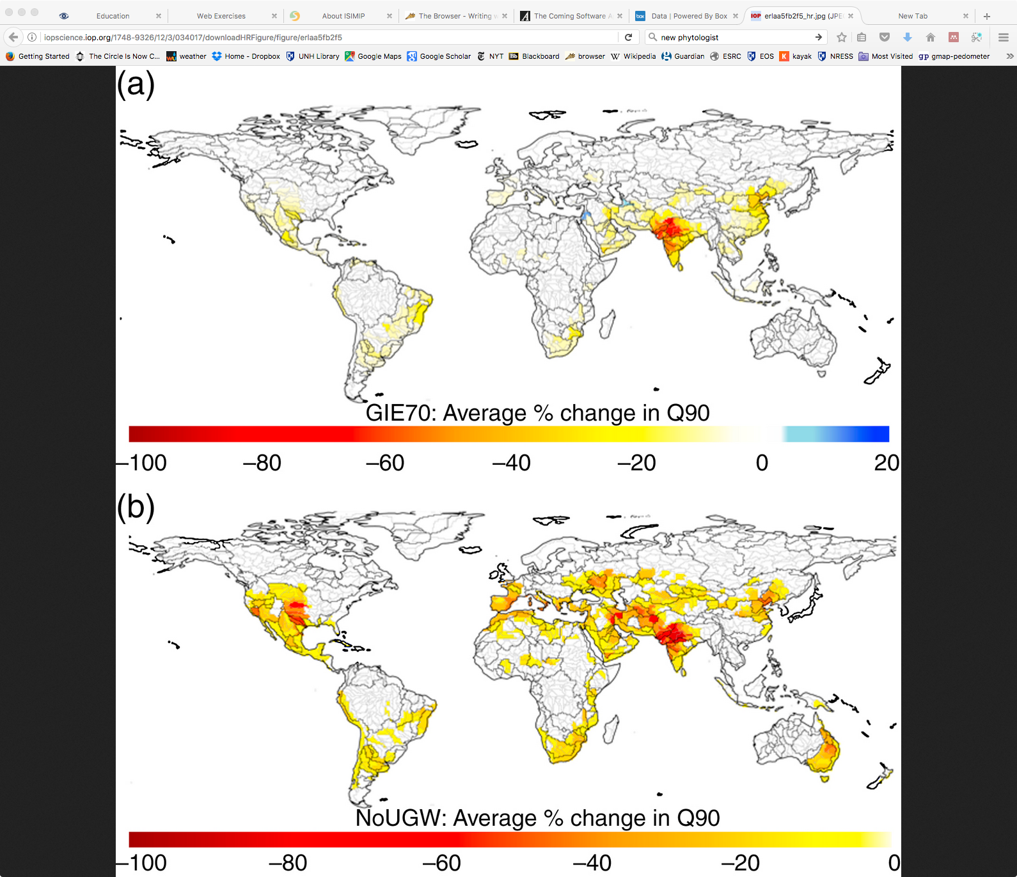
Quantifying Non-Renewable Groundwater Return-Flow and Re-Use in Global Irrigation
Objective
Quantify importance of irrigation return flow to downstream water supply.
Approach
Global hydrological model tracks flow and re-use of non-renewable groundwater pumped for irrigation but ‘lost’ to percolation and run-off.
Assess impact of less irrigation return flow by increasing irrigation efficiency (less water loss), and by using less non-renewable groundwater.
Impact
Inefficient use of irrigation water leads to large amounts of groundwater entering the surface water supply via agricultural runoff, where it can be re-used for irrigation downstream.
Reducing irrigation return flow leads to reduced water supply downstream in major irrigated-agriculture river basins around the world.
Higher efficiency cannot eliminate the need for non-renewable sources for global irrigation water.
Percent change in annual river low flows (lowest 10%) with (a) increased irrigation efficiency, and (b) no non-renewable groundwater use. Both decrease river low-flow values significantly in many major river basins, due to reduced return flow from groundwater irrigation water into the surface water system.
Groga, D. S., Wisser, D., Prusevich, A., Lammers, R. B., & Frolking, S. (2017). The use and re-use of unstainable groundwater for irrigation: a global budget. Environmental Research Letters, 12(3), 34017. https://doi.org/10.1088/1748-9326/aa5fb2

