Slide 1
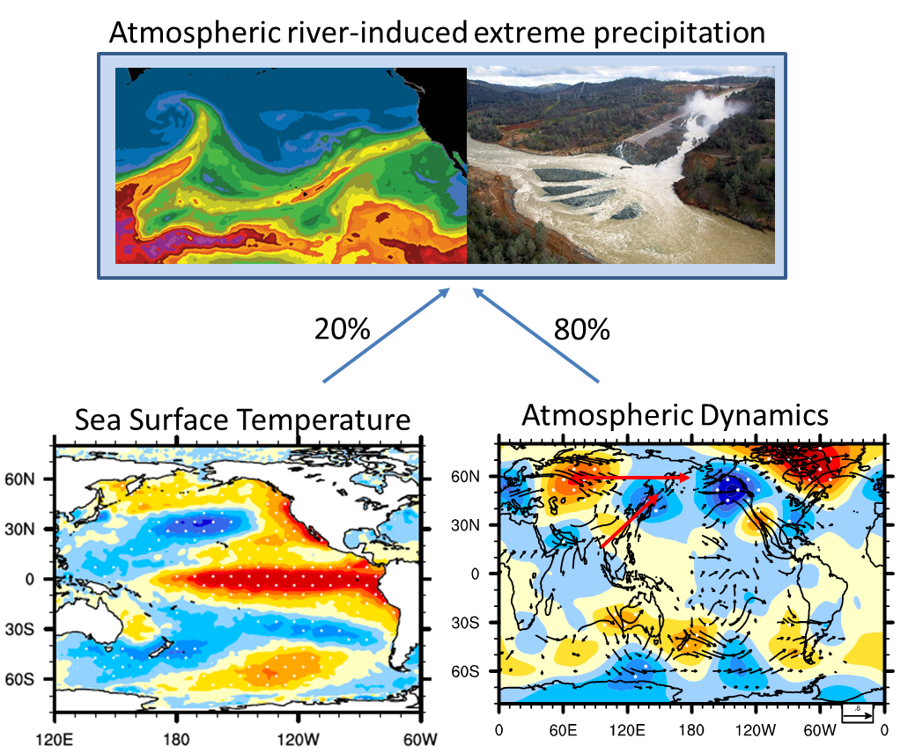
Atmosphere Outpaces Ocean in Driving Extreme Winter Weather along the U.S. West Coast
Objective
Explore large-scale environmental features that favor U.S. West Coast extreme precipitation during winter, focusing on quantifying the roles of sea surface temperature (SST) forcing versus atmospheric variability
Approach
Use ensemble mean of Atmospheric Model Intercomparison Project (AMIP) simulations to suppress atmospheric variability and isolate the effects of SST forcing
Remove the ensemble mean and use residual to calculate the atmospheric component and relate it to circumglobal wave pattern and convection in the tropical western Pacific
Impact
Results showed SST forcing accounted for only about 20% of the variance of both winter extreme and non-extreme precipitation along the U.S. West Coast
Quantifying the relative roles of SST forcing vs. atmospheric variability in extreme precipitation variability is important for understanding the predictability of extreme precipitation because SST and atmospheric variability change on very different time scales
Sea surface temperature, the more predictable element of the climate system, accounts for only 20 percent of extreme precipitation variability along the U.S. West Coast, with atmospheric dynamics explaining the remaining 80 percent.
Dong L, LR Leung, FF Song, and J Lu. 2018. “Roles of SST versus internal atmospheric variability in winter extreme precipitation variability along the U.S. West Coast.” Journal of Climate, 31, 8039-8058. https://doi.org/10.1175/jcli-d-18-0062.1.

