Slide 1
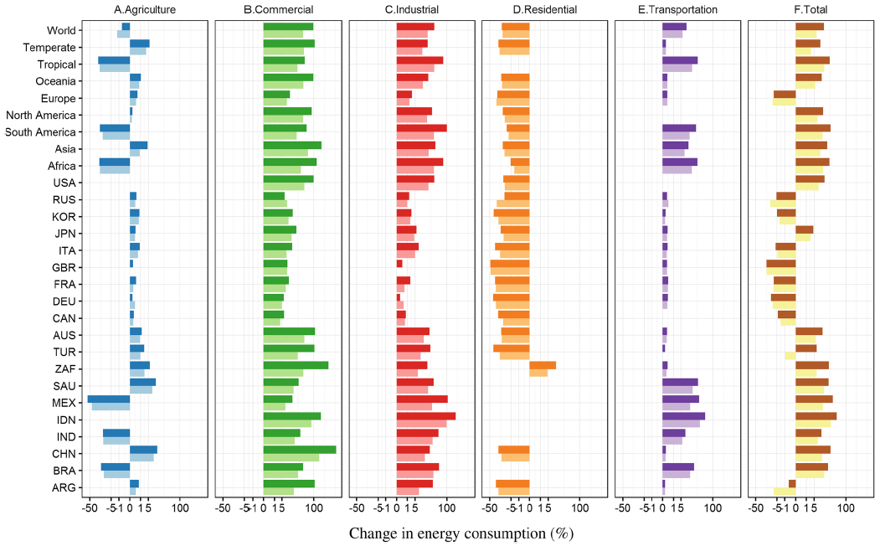
How Will a Warming Climate Influence Global Energy Demand?
Objective
At regional and global scales, project the net impact of warming temperatures on sectoral and aggregate energy consumption, accounting for simultaneous reductions in heating demand and increases in cooling demand.
Approach
Temperature effects on the electricity, natural gas and fuel oil demands of 5 economic sectors were econometrically modeled employing annual time-series for over 80 countries. Responses were combined with GCM temperature projections to estimate impacts.
Impact
Circa 2050, warming could increase global demand by up to 17%. Impacts vary across regions, fuels, and sectors: more positive in the tropics and in the commercial and industrial sectors, but negative in temperate regions’ residential sectors and in Europe in total. drive an overall reduction in aggregate final energy. Warming’s overall impacts are regressive, with increases in total energy demand concentrated in low- and middle-income countries.
Sectoral and aggregate energy demand responses of G20 nations and key world regions to different warming scenarios (RCP 4.5 light colors, RCP 8.5 dark colors), circa 2050. Percentage changes relative to a future no-warming baseline.
De Cian , E., and I. Sue Wing (2019). Global Energy Consumption in a Warming Climate, Environmental & Resource Economics 72(2): 365-410. https://doi.org/10.1007/s10640-017-0198-4

