Slide 1
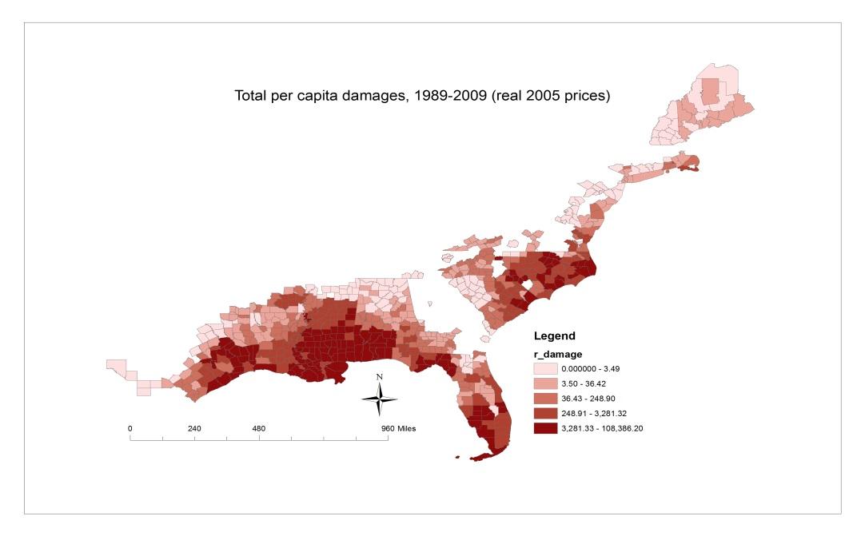
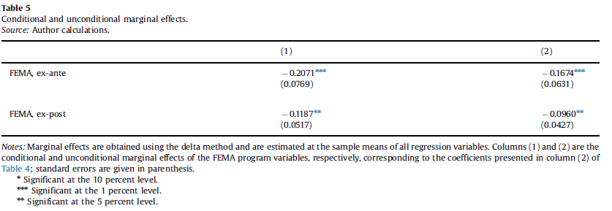
The effects of adaptation measures on hurricane induced property losses
Objective
Measure the relative effectiveness of FEMA expenditures on hurricane induced property losses.
Approach
Compare the relative effectiveness of pre-disaster risk reduction activities and post-disaster response and recovery assistance by econometrically estimating a model of historical property damages.
Model comprises 651 counties along the Atlantic coast that have incurred hurricane-induced property losses at least once during the period 1989-2009.
Impact
Spending on FEMA ex-ante mitigation and planning projects leads to greater reductions in property losses than spending on ex-post adaptation programs.
Marginal return from spending on programs that target long-term mitigation and risk management to be almost twice that from spending on ex-post recovery programs.
There are important potential gains that could be realized from the further diversification of FEMA spending across project categories.
A one percent increase in annual spending on ex-ante risk reduction and warning projects reduces damages by 0.21 percent while a one percent increase in ex-post recovery and clean-up spending reduces damages by 0.12
Davlasheridze, M., Fisher-Vanden, K., Klaiber, H. A. (2017) The effects of adaptation measures on hurricane induced property losses: Which FEMA investments have the highest returns? Journal of Environmental Economics and Management. 81: 93-114. https://doi.org/10.1016/j.jeem.2016.09.005

