Slide 1
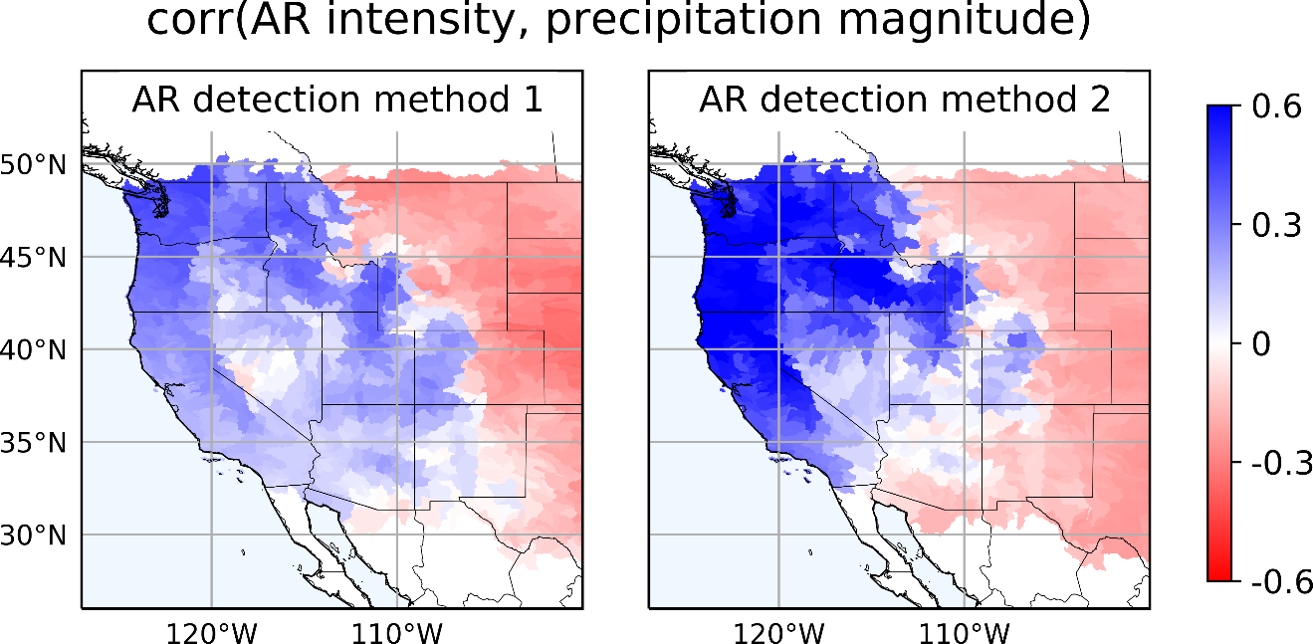
Predicting Extreme Precipitation in the Western U.S. Using Large-Scale Atmospheric Features
Objective
Quantify the relationship between atmospheric rivers (ARs) and extreme precipitation in the western United States
Approach
Perform and analyze high-resolution regional climate simulation of precipitation
Develop machine learning-based classification of ARs, and relate to extreme precipitation
Impact
Revealed use of AR occurrence and magnitude in predicting extreme precipitation in the western United States, with best performance over Pacific Northwest and California
Identified a subset of ARs more closely related to extreme precipitation
By relating extreme precipitation to large-scale ARs, this study provides advanced insights on forecasting of hydrologic extremes
This study revealed the correlation coefficient between the monthly AR activities and the monthly total extreme precipitation amount across small watersheds in the western United States. The two maps show how the correlation varies with different AR detection methods. Overall, ARs have a significant effect on extreme precipitation along the West Coast (i.e., Pacific Northwest and California).
Chen X, LR Leung, Y Gao, Y Liu, M Wigmosta, and M Richmond. 2018. “Predictability of Extreme Precipitation in Western U.S. Watersheds Based on Atmospheric River Occurrence, Intensity, and Duration.” Geophysical Research Letters 45(21):11,693−11,701. https://doi.org/10.1029/2018GL079831

