Slide 1
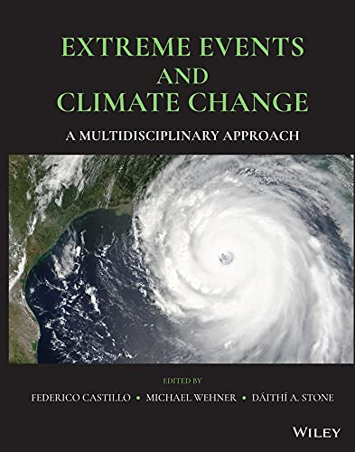

Extreme Events and Climate Change: A Multidisciplinary Approach
As the intensity and frequency of extreme events related to climate change continue to increase, there is an urgent need for clear and cohesive analysis that integrates both climatological and socioeconomic impacts. Extreme Events and Climate Change provides a timely, multidisciplinary examination of the impacts of extreme weather under a warming climate. Offering wide-ranging coverage of the methods and analysis that relate changes in extreme events to their societal impacts, this volume helps readers understand and overcome the methodological challenges associated with extreme event analysis.
The new book discusses topics central to understanding how extreme weather changes as the climate warms
Reviews significant theoretical and modeling advances in the physical aspects of climate science
Presents a comprehensive view of state of the science, including new ways of using data from different sources
“An authoritative volume focusing on multidisciplinary methods to estimate the impacts of climate-related extreme events to society” Image: Wiley & Sons.
Extreme Events and Climate Change: A Multidisciplinary Approach is an indispensable volume for students, researchers, scientists, and practitioners in fields such as hazard and risk analysis, climate change, atmospheric and ocean sciences, hydrology, geography, agricultural science, and environmental and space science.
Federico Castillo, Michael Wehner, Daithi Stone, editors (2021) Extreme Events and Climate Change: A Multidisciplinary Approach. Wiley & Sons. 240 pages. ISBN: 978-1-119-41362-2

