Slide 1
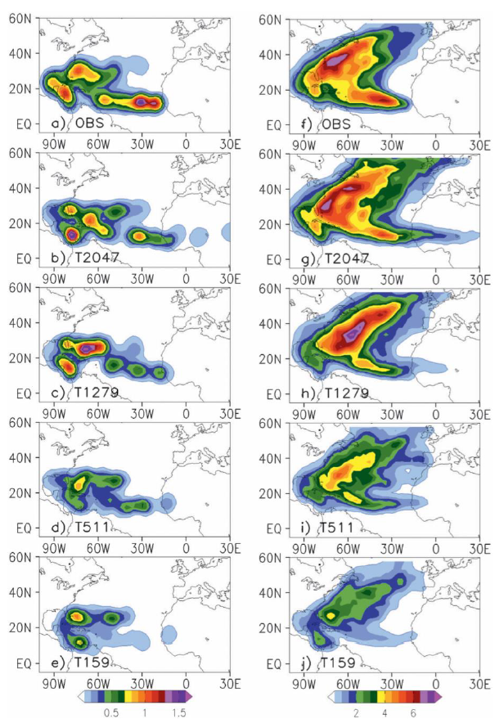
The benefits of global high-resolution for climate simulation: process-understanding and the enabling of stakeholder decisions at the regional scale
We now have the capability to better address extreme weather in a changing climate with global models having horizontal resolutions considerably enhanced from those typically used in previous IPCC and CMIP exercises. The improved representation of weather and climate processes in such models underpins our enhanced confidence in predictions and projections, as well as providing improved forcing to regional models, which are better able to represent local scale extremes.
The computational and analysis cost of this new generation of simulations, in terms of HPC, storage, network speed and analysis platform, is clearly large. New collaborative paradigms will be needed to efficiently address some of these challenges, including use of central analysis platforms, incorporating both data storage and compute, so that algorithms can be moved to the data rather than vice versa. Better coordination can help and greatly enhance the scientific understanding from community analyses of such datasets, using common tools such as TempestExtremes, TECA and climextRemes developed in DOE BER projects.
North Atlantic Ocean (left) genesis and (right) track densities as number density per season per unit area equivalent to a 5˚ spherical cap for (a), (f) IBTrACS (Obs) and IFS simulations at (b), (g) T2047, (c), (h) T1279, (d), (i) T511, and (e), (j) T159 resolutions.
M. J. Roberts, P. L. Vidale, C. Senior, H.T. Hewitt, C. Bates, S. Berthou, P. Chang, H. M. Christensen, S. Danilov, M.-E. Demory, S. M. Griffies, R. Haarsma, T. Jung, G. Martin, S. Minobe, T. Ringler, M. Satoh, R. Schiemann, E. Scoccimarro, G. Stephens, M. F. Wehner (2018) The benefits of global high-resolution for climate simulation: process-understanding and the enabling of stakeholder decisions at the regional scale. Early Release Bulletin of the American Meteorological Society. https://journals.ametsoc.org/doi/10.1175/BAMS-D-15-00320.1

