Slide 1
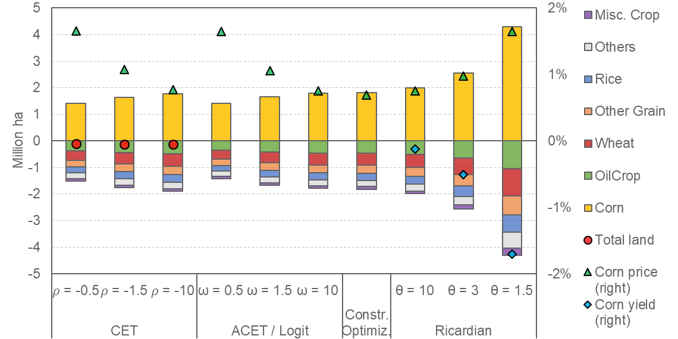
Land Heterogeneity and Conversion Cost Impact Projections of Future Agriculture
Objective
Theoretically compare widely used land use modeling approaches and develop a generalized approach for projecting the global agricultural future and studying climate impacts.
Approach
Developed a hybrid land use model that considers both land conversion cost and land quality heterogeneity.
Introduced the new approach in a simplified GCAM module to compare the effects of corn subsidies or climate impacts on agricultural markets under different assumptions about conversion cost and land heterogeneity.
Impact
Previous studies underestimated climate impacts on agricultural production and markets by ignoring land quality heterogeneity or land conversion costs.
Efforts to improve the quality of new cropland or reduce land conversion cost could help farmers better adapt to climate shocks and alleviate climate impacts on farm revenue and profit.
Comparison of land use change by crop, crop producer price change, and corn yield change across different land use modeling methods as a result of a 5% corn subsidy. Lower 𝜽 implies higher land heterogeneity, while lower 𝝎 implies higher conversion cost, and the new generalized approach includes both parameters. Corn production price (green triangle) and corn land area (yellow bar) vary depending on the model in ways beyond the parameter differences.
X Zhao, K Calvin, and M Wise. 2020. “The critical role of conversion cost and comparative advantage in modeling agricultural land use change,” Climate Change Economics, 11: 2050004.
DOI: 10.1142/S2010007820500049.
Notes:
http://www.pnnl.gov/science/highlights/highlights.asp?division=749

