Slide 1
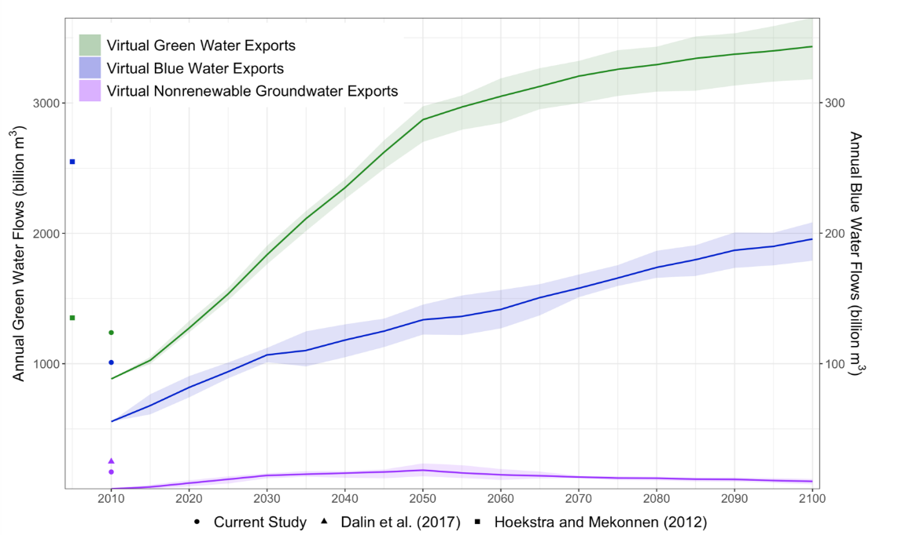
Global Virtual Water Trade Projected to Triple by the End of the Century
Objective
Understand how virtual water trading (i.e., water embedded in traded goods) will evolve in the future.
Approach
Evaluate the impact of evolving human and climate systems on agricultural trading.
Include climate impacts on various water system components, including total water availability.
Quantify the total water, by source, required to grow crops that are then traded to meet international demands that can not be met with domestic water supplies alone.
Impact
Found that freshwater embedded in crop trading will at least triple by 2100 because of future population dynamics and changes in water stress.
Provided first estimate of virtual water across a suite of socioeconomic and climate scenarios. Future research will explore the key drivers of change.
Future socioeconomic and climate evolutions will act to increase the reliance on soil moisture (green water), surface runoff (one type of blue water), and nonrenewable groundwater to meet international agricultural demands, reflected here as exports of virtual water stored in crops.
Graham NT, MI Hejazi, SH Kim, EGR Davies, JA Edmonds, F Miralles-Wilhelm. 2020. “Future changes in the trading of virtual water,” Nature Communications, 11: 3632.
DOI: 10.1038/s41467-020-17400-4
Notes:
http://www.pnnl.gov/science/highlights/highlights.asp?division=749

