Slide 1
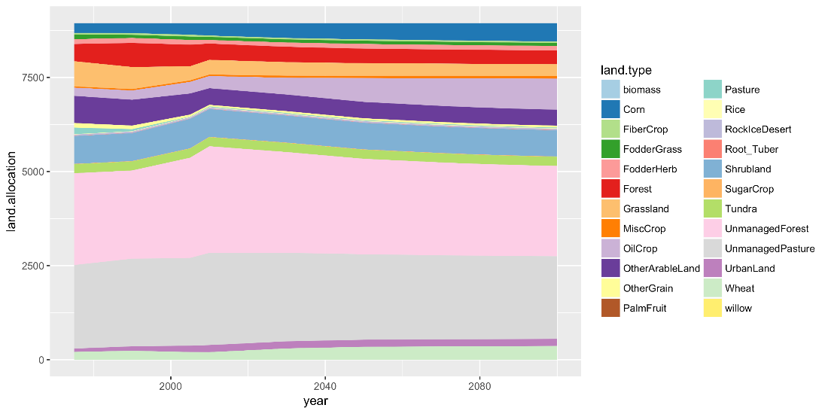
gcamland v1.0 – An R Package for Modeling Land Use and Land Cover Change
Objective
Separate the Global Change Analysis Model (GCAM) land allocation mechanism to enable uncertainty analysis, hypothesis testing, and linking to other models.
Approach
Developed an R package to calculate land allocation, following the algorithms used in GCAM.
Enabled both “hindcast” and future simulation modes.
Implemented both single scenarios and large ensembles of simulations.
PNNL’s gcamland v1.0 provides the global modeling community a new tool to estimate land use and land cover by type.
Impact
The future evolution of land use and land cover is uncertain and has implications for energy, water, and climate.
The gcamland v1.0 package facilitates parameter estimation, validation, and uncertainty analysis for land use and land cover in a way that was not previously possible.
The gcamland v1.0 model can be coupled to other models and tools.
Calvin KV, R Link, MA Wise. 2019. “gcamland v1.0 – An R Package for Modelling Land Use and Land Cover Change,” Journal of Open Research Software, 7:31. DOI: 10.5334/jors.233.
Notes:
http://www.pnnl.gov/science/highlights/highlights.asp?division=749

