Slide 1
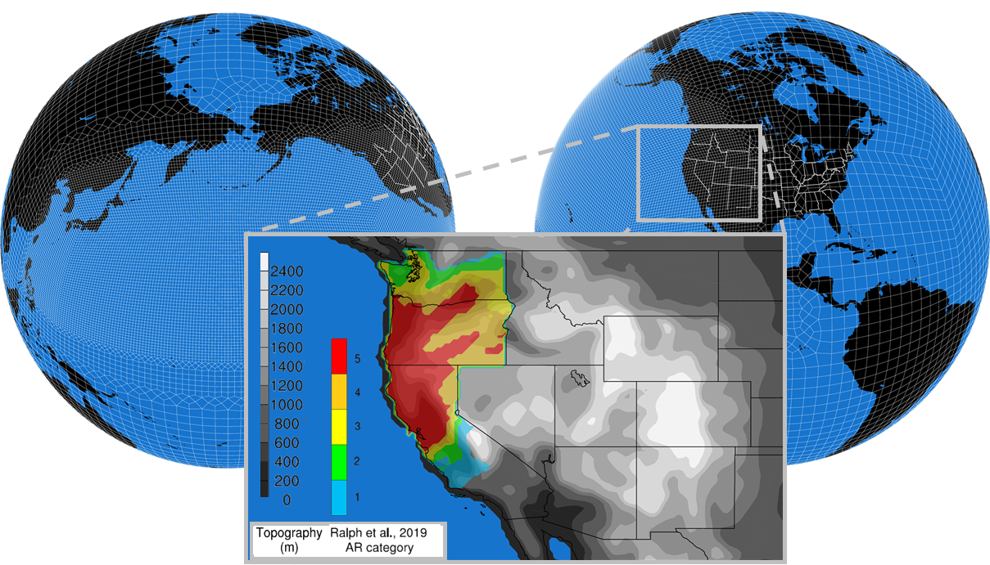
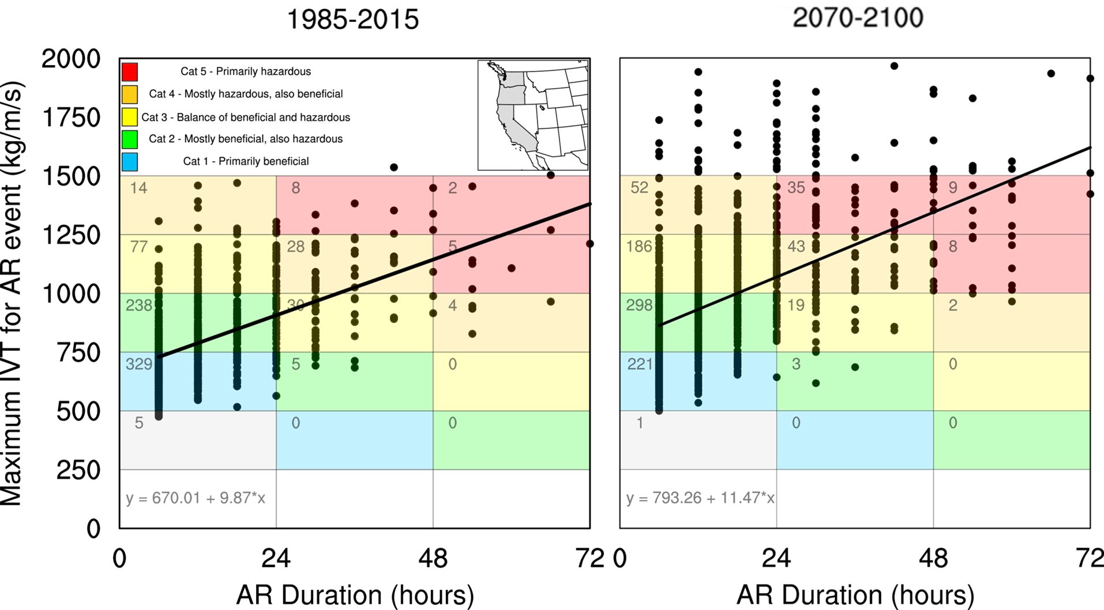
The Shifting Scales of Western U.S. Landfalling Atmospheric Rivers Under Climate Change
VR-CESM based simulations for 1985-2015 and 2070-2100 (RCP8.5) with atmospheric river (AR) tracking using the TempestExtremes AR algorithm with novel extensions developed that attribute each landfalling AR with a Ralph et al., 2019 AR category that attribute the risk-reward aspects of ARs to water management. Each dot represents one AR event.
We investigate how climate change may alter western US landfalling AR characteristics and the nature of their precipitation (e.g., seasonality, storm-totals, and return periods). To do this, we utilize an AR detection algorithm (TempestExtremes) to identify ARs, classify them with the Ralph et al., 2019 AR impacts category scale, and project how AR characteristics may change under climate change using a set of variable-resolution Community Earth System Model simulations.
We highlight a systematic shift in “primarily beneficial” to “mostly or primarily hazardous” ARs with warming (+5 degrees Celsius across coastal western US) and under the most significant warming scenario a precipitation total increase of 4.6%/K is found, primarily due to AR contributed precipitation (+260%) rather than non-AR precipitation (+7%).
At end-century, under a high-emissions scenario, there is an increased number of western US landfalling ARs across all months and a significant shift in AR categories from “mostly or primarily beneficial" to “mostly or primarily hazardous“ is projected, with several ARs that fall off the Ralph et al., 2019 AR impact scale.
A net increase of +22% in 30-year precipitation totals (+6440 mm), predominantly from AR precipitation (+260%, +5320 mm or +180 mm/year), is projected.
No single end-century Cat 5 AR event precipitation total is historically unprecedented, however the increased number of Cat 4 and 5 landfalling ARs and, particularly back-to-back Cat 5 AR events, is. This results in a maximum monthly precipitation total nearly double that found in the historical period.
Rhoades, A. M., Jones, A. D., Srivastava, A., Huang, H., O'Brien, T. A., Patricola, C. M., et al. (2020). The shifting scales of western U.S. landfalling atmospheric rivers under climate change. Geophysical Research Letters, 47, e2020GL089096. https://doi.org/10.1029/2020GL089096

