Slide 1
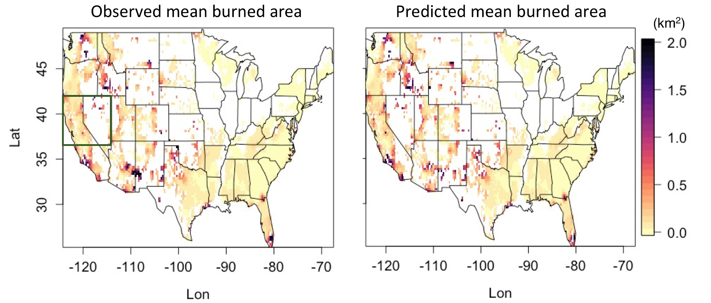
Using Explainable AI to Understand Key Wildfire Controls
Objective
Develop a machine learning (ML) model to predict wildfire burned areas over the contiguous U.S. and identify key factors controlling wildfires.
Approach
Incorporate multiple predictors to develop an ML model to accurately predict burned area.
Improve prediction accuracy by incorporating new predictors that capture the influence of large-scale meteorology on wildfires.
Utilize a game-theory-based interpretation to explain the predictions and determine the important predictors used in the ML prediction.
Impact
A newly developed ML model accurately predicts wildfire burned areas at a fine spatial resolution across the U.S.
The coordinate variables, or geographical locations, contribute to the burned area prediction by differentiating the temporal characteristics of different fire regimes.
Fire-season fuel dryness and dry winters associated with large-scale meteorological patterns are important contributors to large burned areas in the western and southeastern U.S., respectively.
By incorporating a game-theory-based interpretation, the new ML model successfully reproduced the spatial distributions of wildfire burned area averaged over 2000 to 2017. The above maps show good agreement between observations and predictions based on multiple factors, including meteorology, vegetation, landscape, and human impacts.
S. S.-C. Wang, Y. Qian, L. R. Leung, and Y. Zhang. 2021. “Identifying key drivers of wildfires in the contiguous US using machine learning and game theory interpretation,” Earth’s Future, 9, e2020EF001910, (2021). [DOI: 10.1029/2020EF001910]

