Slide 1
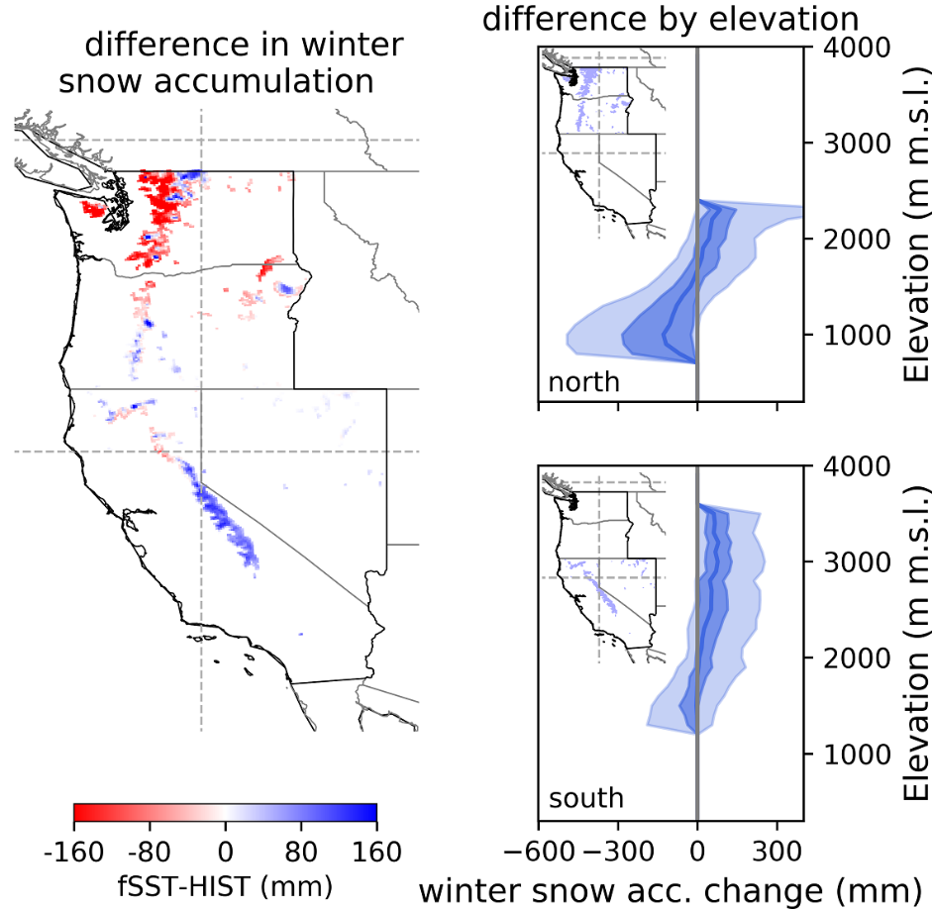
Contrasting Responses of Mountain Snowpack to Warmer Sea Surfaces
Objective
Quantify the impact of local, sea surface temperature (SST) on U.S. West Coast mountain snowpack.
Approach
Conduct two regional climate simulations with different local SST conditions.
Analyze the meteorological and snowpack changes under warmer, local SST.
Develop two machine learning models to explain the physics-based model’s simulated snowpack response.
Impact
Revealed divergent snowpack responses to local SST featuring reduced and enhanced snowpack in the Cascade and Sierra Nevada mountain ranges, respectively.
Identified the magnitude and temperature of precipitation as key drivers of snowpack responses.
Machine learning models enhance understanding and predictions of West Coast mountain snowpack.
Local SST may provide useful data for predicting the mountain snowpack, which is important for coastal region water resources.
Compared to the control climate (HIST), a simulation with warmer local SST (fSST) shows reduced winter snowpack in the Cascade range and enhanced winter snowpack in the Sierra Nevada (left panel). Precipitation and temperature control the divergent responses, which depend on surface elevations (right panels).
X. Chen, L. R. Leung, Y. Gao, and Y. Liu. “Response of U.S. West Coast Mountain Snowpack to Local Sea Surface Temperature Perturbations: Insights from Numerical Modeling and Machine Learning.” J. Hydrometeor. 22, 1045, (2021). [DOI: 10.1175/JHM-D-20-0127.1]
Notes:
http://www.pnnl.gov/science/highlights/highlights.asp?division=749

