Slide 1
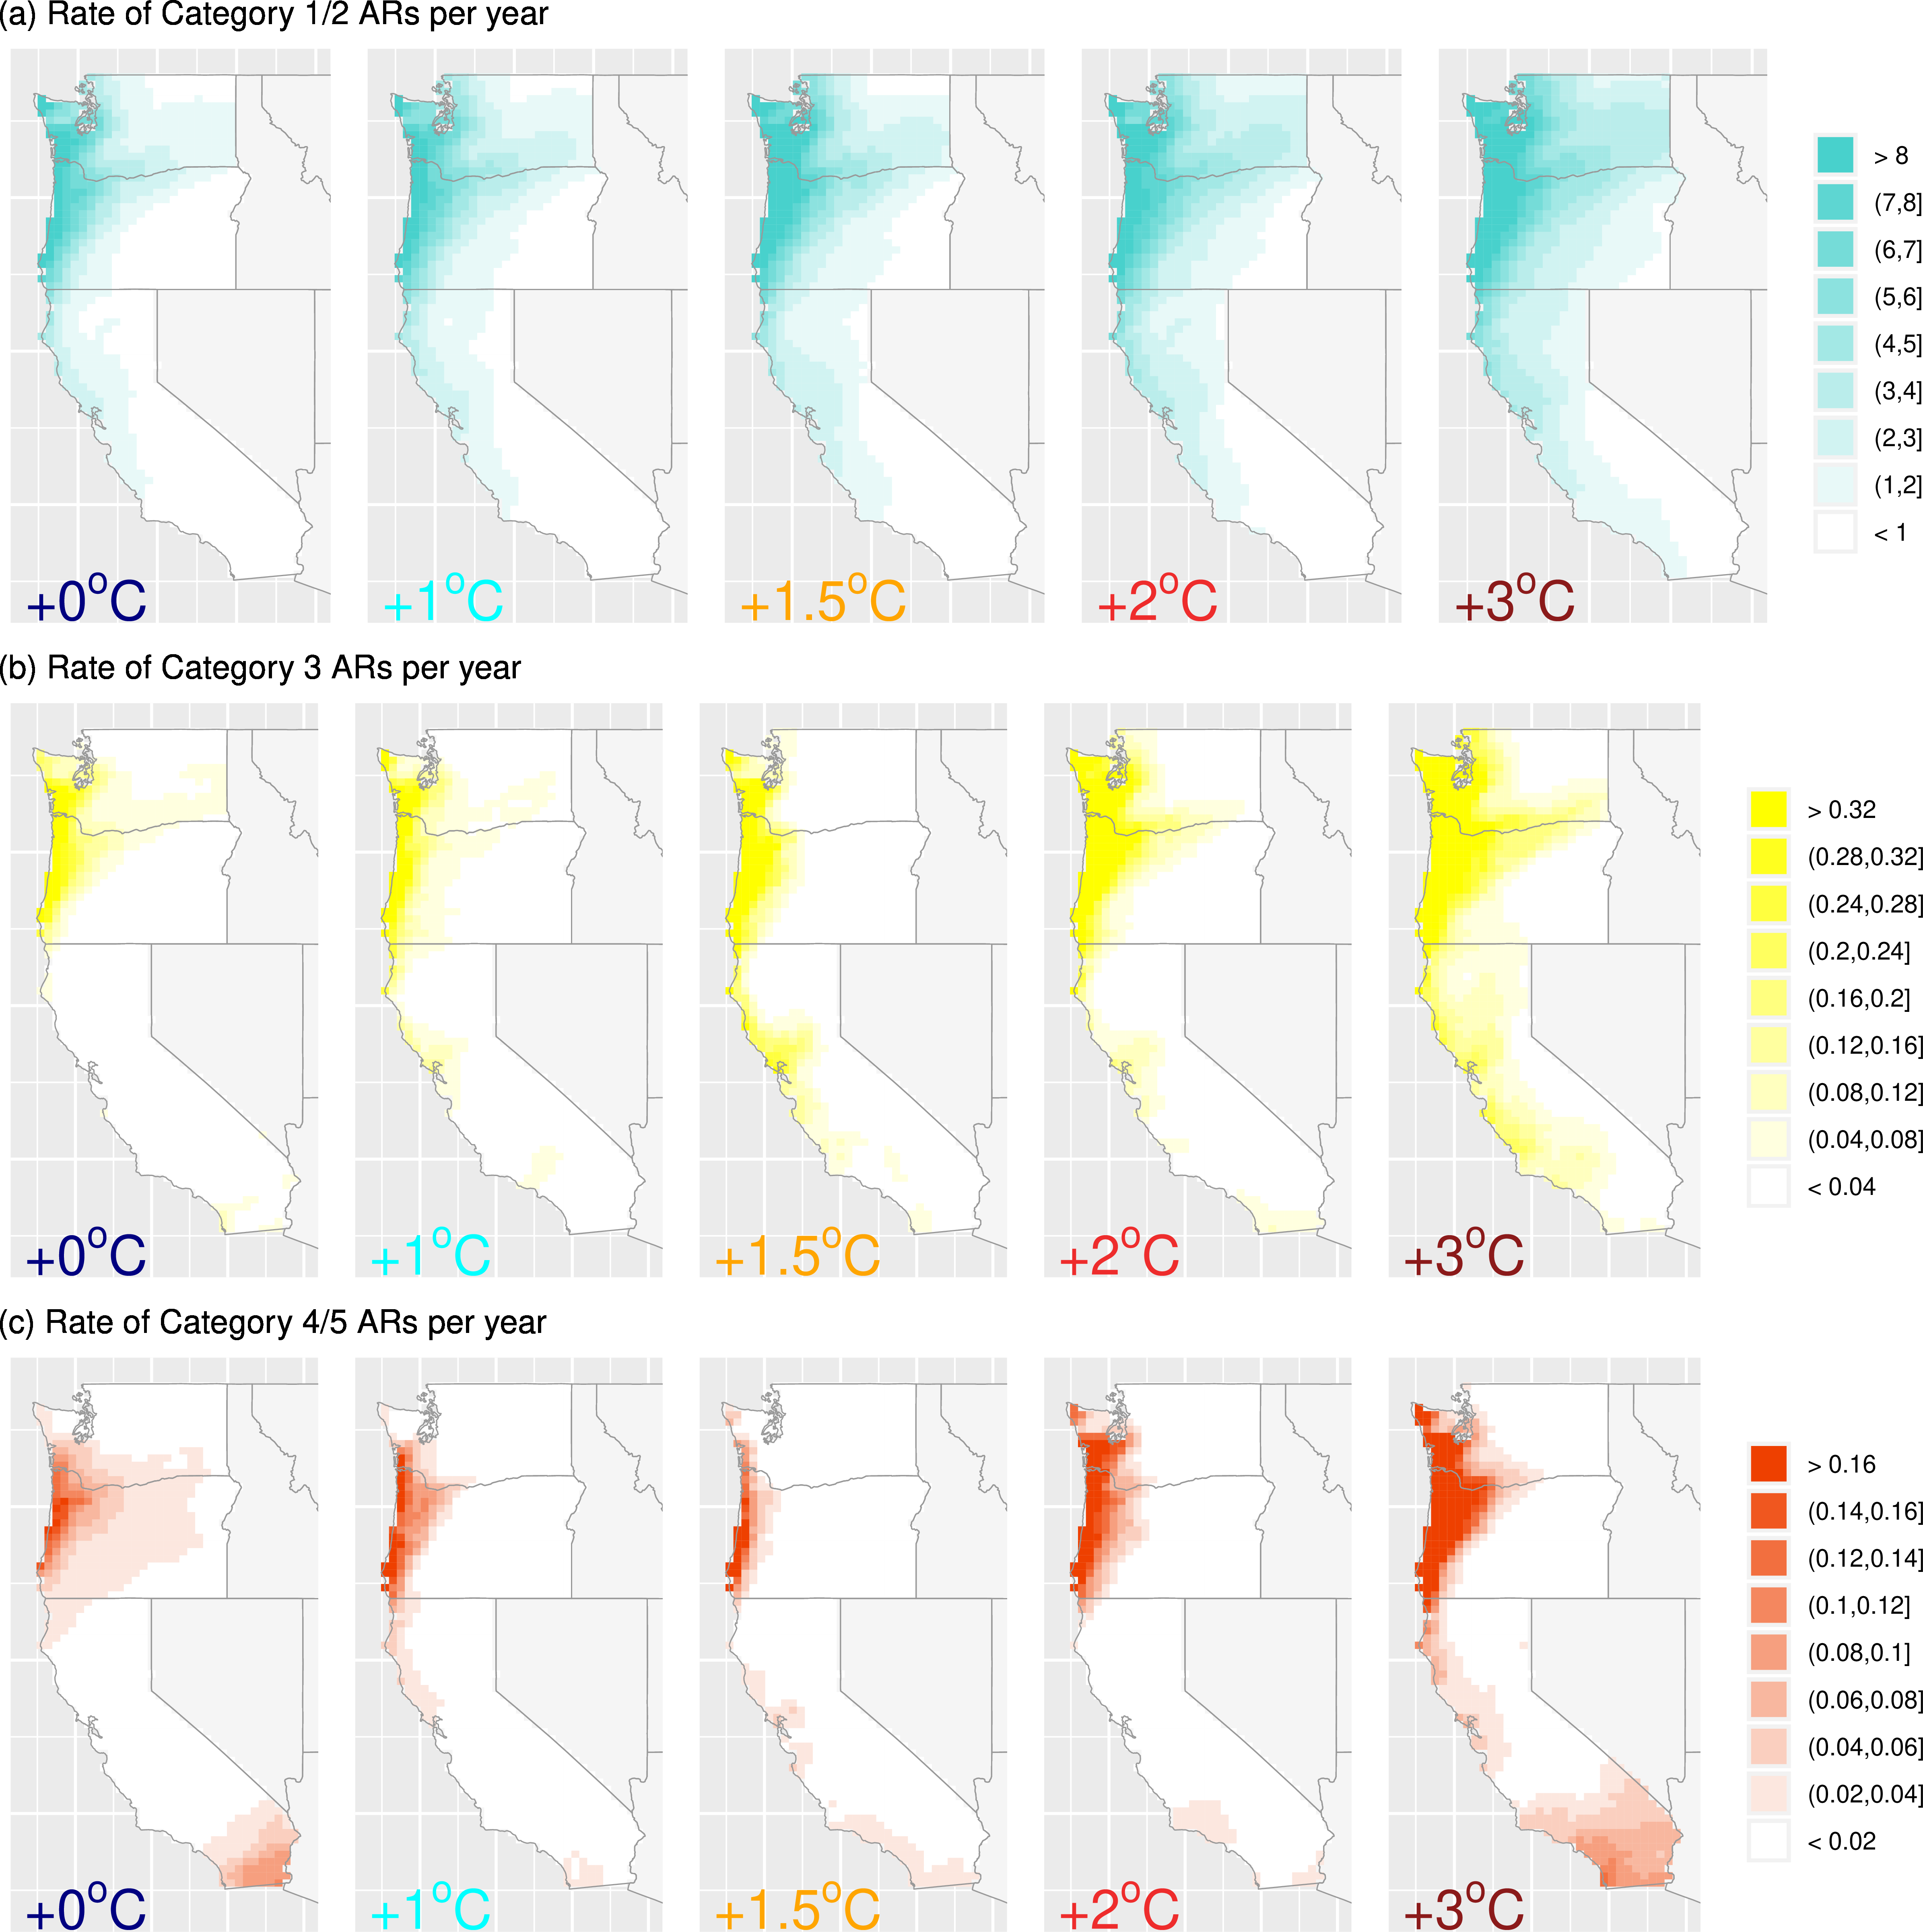
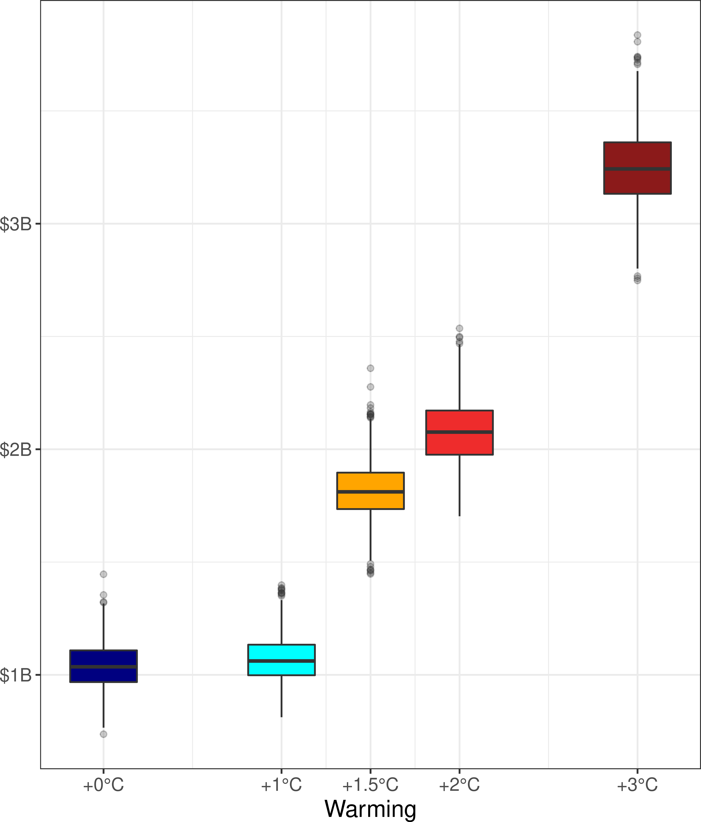
Implications of warming on western United States landfalling atmospheric rivers and their flood damages
(Left) Per year landfalling AR estimates across warming experiments. ARs were binned according to the Ralph et al., 2019 AR category scale that met a) Cat 1-2 “mostly or primarily beneficial”, b) Cat 3 “balance between beneficial and hazardous”, and c) Cat 4-5 “mostly or primarily hazardous” to water resource management.
Scientific Challenges
Atmospheric rivers (ARs) are critical to the western US water cycle. Based on their landfalling characteristics they can either be beneficial or detrimental to water managers. We investigate shifts in AR characteristics along different stabilized global warming scenarios and highlight the pragmatic implications of climate mitigation aimed at keeping global warming under +2◦C.
Approach and Results
We combine a newly developed AR detection workflow (TempestExtremes) with 0.25° Community Earth System Model simulations designed to simulate a world that might have been (+0◦C), a world that corresponds to present day warming (+0.85◦C), and several future worlds (+1.5◦C, +2◦C and +3◦C).
Significance
Global warming increases the number of water management relevant landfalling ARs from 19.1 ARs per year (+0◦C) to 23.6 ARs per year (+3◦C) along the coastal western US.
Importantly, warming also increases the fraction of ARs that are “mostly or primarily hazardous” to water resource management with 2% of ARs at +0◦C to 8% at +3◦C.
This subtle-but-important shift in AR character has important ramifications on flood damages, whereby for every +1◦C of additional warming from present conditions we found that annual average flood damages increase by ~$1 billion.
(Right) Coastal western US annual AR flood damage estimates (billions of $) across global warming experiments
Rhoades, A. M., Risser, M. D., Stone, D. A., Wehner, M. F., & Jones, A. D. (2021). “Implications of warming on western United States landfalling atmospheric rivers and their flood damages.” Weather and Climate Extremes, doi:10.1016/j.wace.2021.100326.

