Slide 1
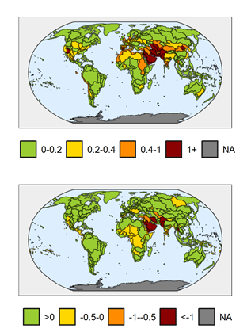
Evaluating the Economic Impact of Water Scarcity in a Changing World
Objective
Calculate the economic impact of water scarcity under many different future human and environmental influences.
Approach
Generate thousands of future scenarios by combining discrete levels of supply- and demand-side drivers of water scarcity.
Calculate how the water market economic surplus changes between a scenario with a bounded water supply and a corresponding scenario with unlimited water.
Impact
This metric reflects the economic impact of adapting to water scarcity and provides a fuller picture of regional vulnerabilities, as regions have different capacities to respond to water stress. Basins can experience highly positive or severely negative impacts from water scarcity
The novel treatment of uncertainty shows that the main drivers of economic impact differ across regions and cannot be simply assumed.
Maps showing medians of physical water scarcity (withdrawals over renewable supply) across scenarios (top), and medians of the log-modulus of the economic impact of water scarcity (billions US$) across scenarios (bottom). The two metrics do not perfectly correspond, emphasizing the need to consider both physical scarcity and economic impact when conducting water scarcity analyses.
F. C. Dolan, J. R. Lamontagne, R. P. Link, M. I. Hejazi, P. M. Reed, J. A. Edmonds. “Evaluating the economic impact of water scarcity in a changing world.” Nature Communications. 12, 1915 (2021). [DOI: 10.1038/s41467-021-22194-0].

