Slide 1
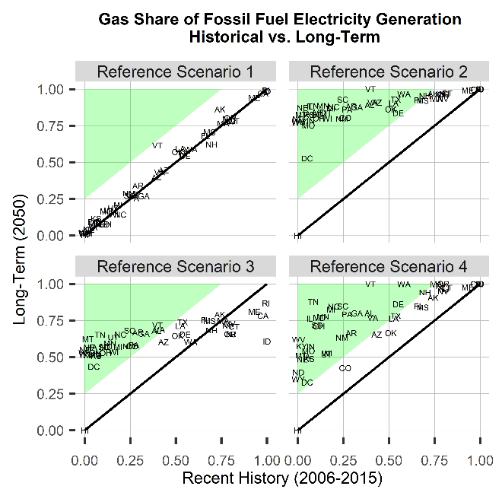
A New Framework for Evaluating Model-Based Energy Scenarios
Objective
Develop a framework for evaluating future energy system scenarios to improve their consistency and credibility.
Approach
Create a three-part evaluation framework composed of (1) a qualitative vision, (2) quantitative metrics, and (3) evaluation criteria.
Apply this framework to GCAM-USA, a version of the Global Change Analysis Model with subnational detail in the US, focusing on the electric power sector reference scenario.
Impact
Using a structured evaluation framework helps scientists identify and correct model deficiencies; refine their understanding future energy system evolution; and highlights interesting exceptions to anticipated trends.
The general framework is flexible and can be applied to a variety of regions and sectors.
A scenario evaluation framework helps researchers explore how model results compare to expected outcomes (shaded green area) for specific metrics, shown for gas share of fossil fuel electricity generation here.
Binsted M.T., G.C. Iyer, Y. Cui, Z. Khan, K.R. Dorheim, and L.E. Clarke. “Evaluating long-term model-based scenarios of the energy system.” Energy Strategy Reviews, 32, 1005512, (2020). [DOI: 10.1016/j.esr.2020.100551]

