Slide 1
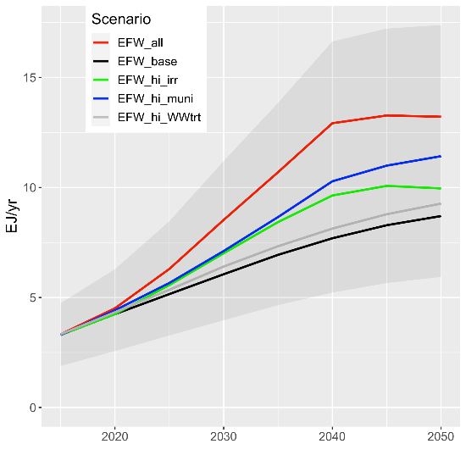
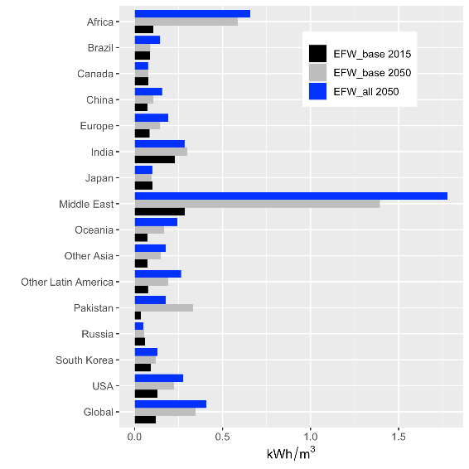
Assessing the Future of Global Energy-for-Water
Objective
Incorporate water-related energy use, energy-for-water (EFW), into the Global Change Analysis Model (GCAM) and analyze its impacts on long-term energy demand.
Approach
Incorporate historical EFW estimates into GCAM and re-balance regional energy consumption estimates to accommodate explicitly modeled EFW.
Explicitly represent electrical pumping requirements by using a global gridded simulation tool (Superwell) to construct groundwater supply curves.
Analyze a range of scenarios that represent meeting water-related Sustainable Development Goals: expanded irrigation, improved water access, reduced discharge of untreated wastewater.
Impact
This study establishes both the data and methods needed for multi-system models to explicitly represent energy-for-water.
While EFW currently uses 3.3 EJ/yr globally (4.0% of total electricity consumption), it reaches between 9 and 13 EJ by 2050 in the studied scenarios.
Energy-for-water increases from 2015 to 2050 by between 2.5x to 4x, depending on the specific scenario (left panel). This is driven by growth in future water demands and their associated treatment needs, as well as by increases in the energy intensity of freshwater production driven by water scarcity (right panel).
Kyle GP, M Hejazi, S Kim, P Patel, N Graham, and Y Liu. “Assessing the Future of Global Energy for Water,” Environmental Research Letters, 16, 024031, (2021).
DOI: 10.1088/1748-9326/abd8a9
Notes:
http://www.pnnl.gov/science/highlights/highlights.asp?division=749

