Slide 1
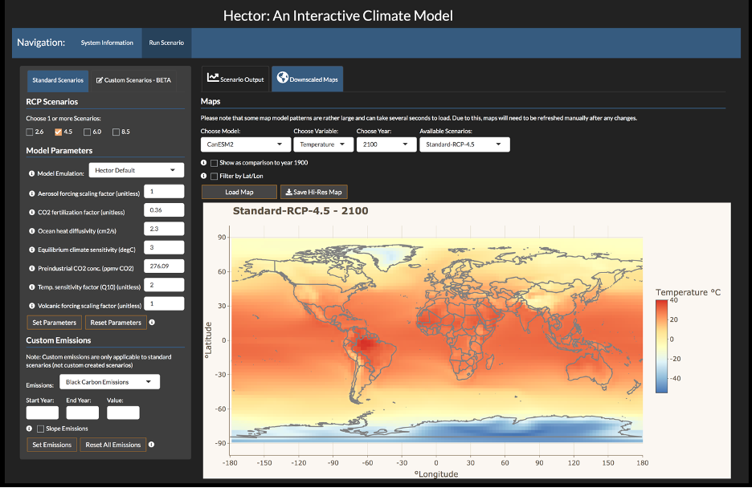
Making a Simple Climate Model More Accessible Through Online Visualization
Objective
Create an accessible user interface for the Hector simple climate model that allows real-time parameterization, execution, and visualization of climate simulations from a web browser.
Approach
Build a web-based user interface that can accommodate a broad range of potential users.
Provide users with a custom online tutorial that shows them how to create custom configurations and “try out” the Hector model under different assumptions.
Generate model results with interpretable visualizations in real time.
Impact
Provides model accessibility to anyone with the internet and a web browser—no prior knowledge necessary.
Promotes classroom use to demonstrate key concepts of climate modeling, broadening the reach of the MultiSector Dynamics community to future generations of researchers.
Image of gridded temperature output from the Hector user interface based on its default configuration. This interface allows anyone with the internet and a web browser to utilize the Hector climate model—no additional software necessary!
Evanoff J, CR Vernon, S Waldhoff, A Snyder, C Hartin. 2020. “hectorui: A web-based interactive scenario builder and visualization application for the Hector climate model.” — Journal of Open Source Software 5(56):2782, DOI: 10.21105/joss.02782.
Notes:
http://www.pnnl.gov/science/highlights/highlights.asp?division=749

