Slide 1
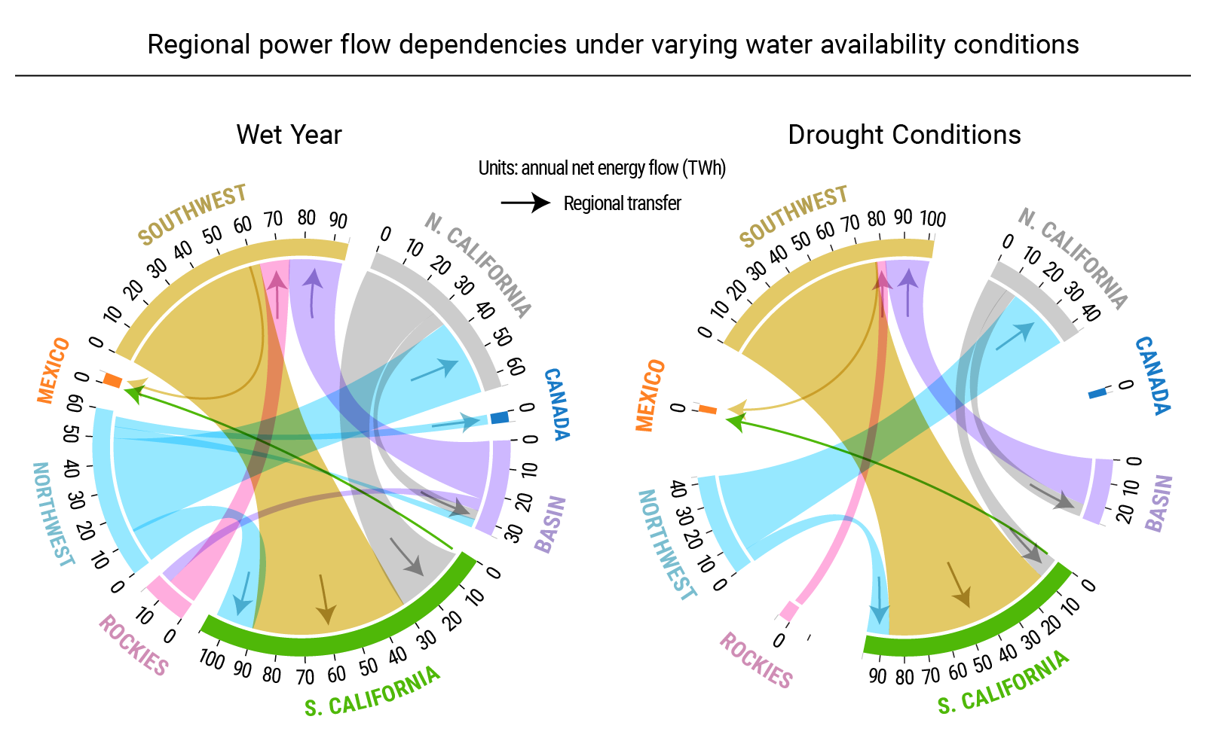
Complex regional interactions modulate the sensitivity of power grid operations to climate change
Objective
Understand how regional interactions contribute to the enhancing or mitigating of climate change induced stress on electric grid operations.
Approach
Translate future hydrologic projections into hydropower generation and water-dependent thermo-electric plant capacity constraints that can inform a power grid system model.
Analyze 300 years of simulated historical and future regional and system-scale power system operations.
Net interchange between region pairs for wet and drought year conditions in TWh/year. The sensitivity of regional dependency paths to water availability is conserved under climate change conditions.
Impact
Power generation in the Desert Southwest alleviates changes in Northwest water availability to support electricity demand in Southern California.
Regional power flow directions are maintained under future hydrologic projections. However, regional long term energy planning needs to consider regional dependencies and climate change adaptation plans.
Voisin, N., Dyreson, A., Fu, T., O'Connell, M., Turner, S. W. D., Zhou, T., & Macknick, J. (2020). Impact of climate change on water availability and its propagation through the Western U.S. power grid. Applied Energy, 276, 115467. doi: https://doi.org/10.1016/j.apenergy.2020.115467
Notes:
http://www.pnnl.gov/science/highlights/highlights.asp?division=749

