Slide 1
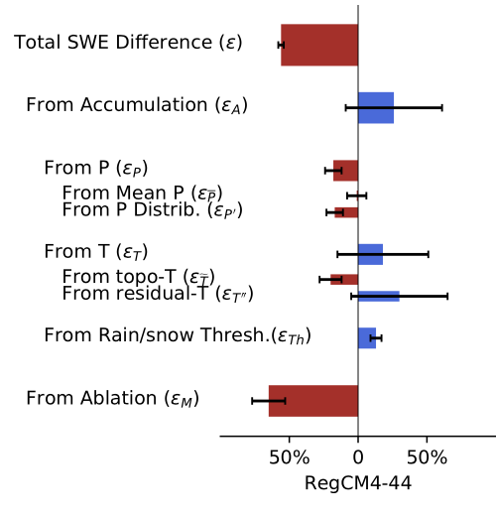
A quantitative method to decompose SWE differences between regional climate models and reanalysis datasets
We developed a method to identify which processes in regional climate models are responsible for errors in the simulation of peak snow accumulation in mountainous regions.
Accurately predicting snow dynamics requires models that can simulate the underlying processes and produce the right answers for the right reasons. Our method identifies which processes must be improved in regional climate models to more accurately simulate snow dynamics.
We design a framework to quantitatively decompose the SWE difference contributed from precipitation distribution and magnitude, ablation, temperature and topography biases in regional climate models.
We apply this framework within the California Sierra Nevada to four regional climate models from the North American Coordinated Regional Downscaling Experiment (NA-CORDEX)
Bias arises from spatial and elevational distribution of precipitation, cold biases, uncertainties in the rain-snow partitioning threshold, and high ablation biases.
Total peak snow water equivalent (SWE) error is decomposed into contributions from precipitation, temperature, and ablation processes, including their spatial patterns.
Citation: Xu, Y., A.D. Jones, A.R. Rhoades (2019), A quantitative method to decompose snow water equivalent differences between regional climate models and reanalysis datasets, Scientific Reports, https://doi.org/10.1038/s41598-019-52880-5.

