Slide 1
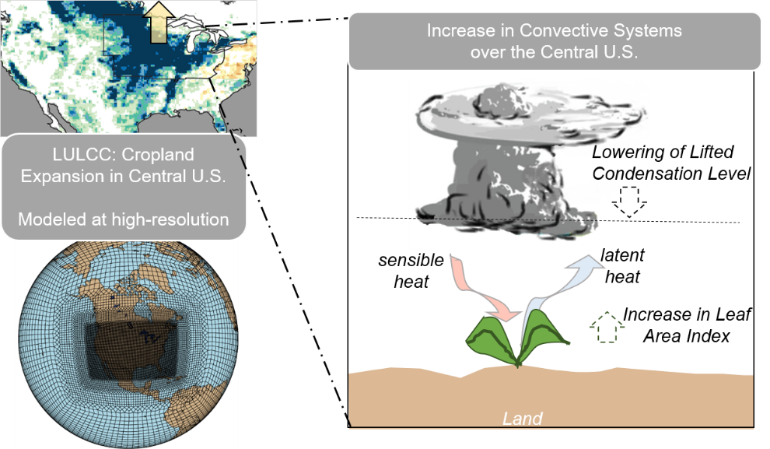
Land Use and Land Cover Change Strongly Alters Warm-Season Precipitation Over the Central U.S. in Variable-res Earth System Simulations
Objective
Understand the impacts of land use and land cover change (LULCC) on warm-season precipitation over the Central U.S.
Approach
Perform numerical experiments using standard and variable-resolution configurations of the Community Earth System Model with representations of land conditions corresponding to pre-industrial and present-day time periods.
Benchmark simulated precipitation, temperature, and mesoscale convection statistics against observations and quantify land–atmosphere coupling strength.
Evaluate the responses of surface fluxes and the thermodynamic environment to LULCC over the Central U. S. at multiple land and atmospheric resolutions.
Impact
Stronger LULCC-induced warm-season precipitation over the Central U.S., corresponding to an increase in the number of mesoscale convective system-like features and a more conducive thermodynamic environment for convection, can be captured in variable-resolution simulations.
Demonstrates the potential of variable-resolution global models for capturing extreme convective storms in regions with significant LULCC.
The expansion of croplands over the Central U.S. shifts the thermodynamic environment, making it more conducive to convection and resulting in an increase in the number of mesoscale convective system-like features.
Devanand A, M Huang, D M Lawrence, C M Zarzycki, Z Feng, P J Lawrence, Y Qian, Z Yang. “Land use and land cover change strongly modulates land‐atmosphere coupling and warm‐season precipitation over the Central United States in CESM2‐VR,” Journal of Advances in Modeling Earth Systems, 12, e2019MS001925, (2020). DOI: 10.1029/2019MS001925

