Slide 1
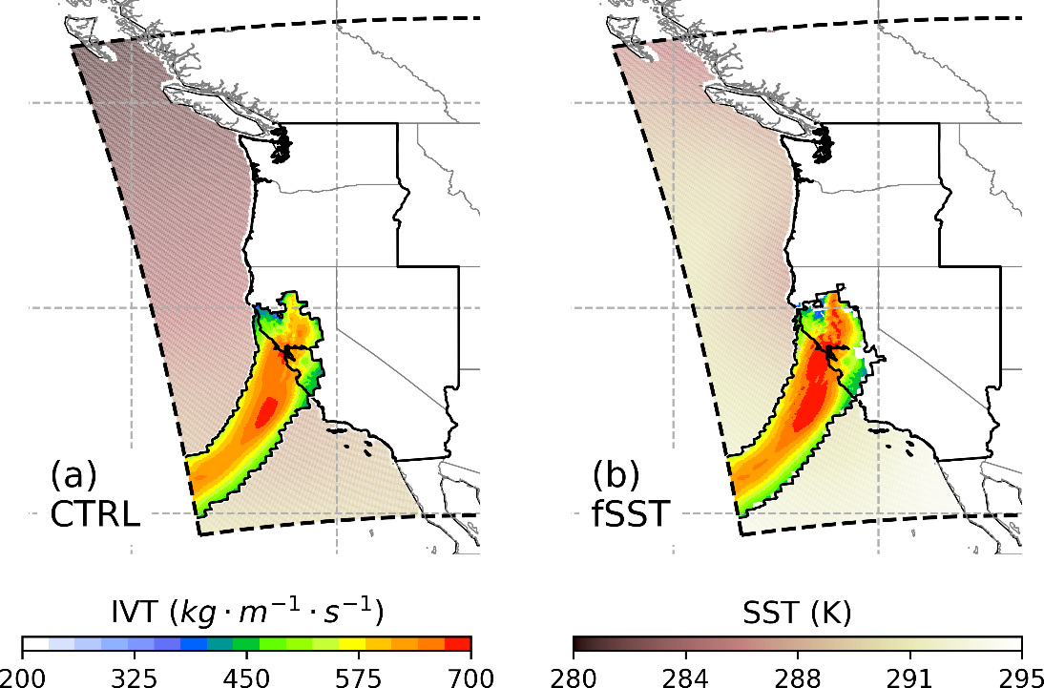
Warmer Sea Surfaces Intensify Landfalling Atmospheric Rivers
Objective
Isolate and quantify the impact of local sea surface temperature (SST) on landfalling atmospheric rivers (ARs) and the precipitation they bring to the U.S. West Coast.
Approach
Conduct two regional climate simulations with different local SST conditions.
Track the simulated ARs and generate high-resolution AR spatial coverage datasets based on the two simulations.
Analyze how the AR features and precipitation levels respond to different SST conditions during the AR events.
Impact
Identified robust linear responses of AR intensity and precipitation to increases in local SST.
Revealed that local SST has a larger impact on AR precipitation than AR intensity, as the warmer ocean surface destabilizes the storms.
Increased knowledge of the local SST can be used to improve predictions of overall AR precipitation and flood risk.
An AR hitting the United States West Coast on May 28, 2005 in (a) the control (CTRL) simulation using the observed SST data and (b) a simulation (fSST) with warmer local SSTs. The AR integrated vapor transport (IVT) has higher intensity and broader spatial coverage in (b) than (a) due to the warmer SSTs.
Chen, X., & Leung, L. R. (2020). Response of Landfalling Atmospheric Rivers on the U.S. West Coast to Local Sea Surface Temperature Perturbations. Geophysical Research Letters, 47. DOI: 10.1029/2020GL089254
Notes:
http://www.pnnl.gov/science/highlights/highlights.asp?division=749

