Slide 1
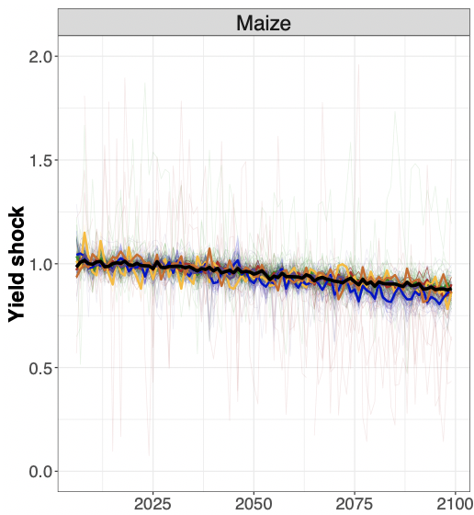

Future Climate Impacts on Global Agricultural Yields Over the 21st Century
Objective
Estimate the annual response of crop yields to growing season temperature and precipitation using historical data.
Produce panels of annual, country-level agricultural yield shocks for 12 crops under multiple future temperature and precipitation pattern projections.
Approach
Use historical crop yield and weather data to construct reduced-form statistical models for 12 crops and empirically estimate their annual yield responses to growing season temperature and precipitation.
Couple response functions with Earth System Model temperature and precipitation projections to estimate future yield shocks under two distinct warming scenarios.
Impact
Data on country-level impacts enable consistent analysis from multiple economic models with different needs for regional and crop aggregations.
Provides a framework for estimating future yield impacts for any alternative climate scenario or crop for which the data are available.
Annual yield impact estimates enable economic analyses to move beyond exploring longer-term trends toward understanding the effects of interannual variability in yields.
Modeled maize yields that are aggregated either continentally or globally (heavy lines) show a relatively steady decline in yield. However, this masks significant annual variability (pale lines) in individual countries. These changes have the potential to generate large economic effects in both the individual countries and globally, through impacts on trading partners.
Waldhoff ST, Sue Wing I, Edmonds JA, Zhang X, Leng G. 2020. “Future climate impacts on global agricultural yields over the 21st century.” Environmental Research Letters. DOI: 10.1088/1748-9326/abadcb
Notes:
http://www.pnnl.gov/science/highlights/highlights.asp?division=749

